Slide 1
The Project Life Cycle

Slide 2
Phases of a project
Project categories
Project Selection
Pre-Initiation
Initiation
Planning
Implementation (Executing)
Monitor and Control
Closing

Slide 3
Project Categories
Venture/innovation projects = Transform the business projects (new product/services)
Growth projects = Grow the business projects (increase market share and/or revenue/profit)
Core projects = Run the business projects (keep the plane flying)

Slide 4
Project selection phase
Enterprise leaders meet and determines strategic direction (for venture/innovation, and to a lesser extent, growth projects)
Leaders and key individuals submit ideas/plans which support strategic direction
Enterprise leaders review ideas/plans and select best ideas/plans which they have resources to accomplish

Slide 5
Pre-initiation phase
Lay the ground work for the project:
Determine scope, time, and cost constraints
Identity project sponsor
Select and meet with project manager
Develop business case
Determine project structure

Slide 6
Initiation phase
Project sponsor is identified
Scope and deliverables are defined
Relationship to organizational goals is key
Budget is approved
Broad statements are made about risks, approach, timelines
Stakeholders are identified
Project Manager is assigned
At end of phase, approved project charter is the approval to proceed to the planning phase

Slide 7
Planning phase
Deliverables are clearly defined
Based on the deliverables, a Work Breakdown Structure (WBS) defines the “work packages”
The work packages are used to develop a schedule and budget
Plans are made for management of stakeholders, communication, quality, costs, risks, procurement, resources including human resources

Slide 8
Implementation (Execution) Phase
Project team is hired and developed
Procurements take place
Project work is underway
Project must be monitored and changes managed
Communication to stakeholders is an important ongoing activity

Slide 9
Monitor and Control
Monitor and control project work
Perform integrated change control
Validate and control Scope, Time, Budget, and Quality
Control Communications, Risks, Procurement, and Stake Holders

Slide 10
Closing phase
Reporting
Closing out procurements—final payments
Identify lessons learned
Celebrate

Slide 11
Project Phase Overlap

Slide 12
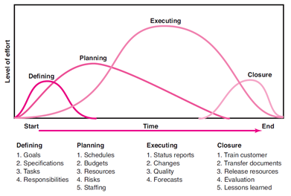
Project Phase Overlap

Slide 13
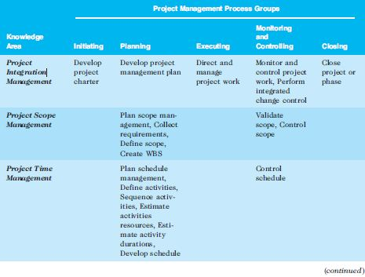
PMI Processes and Knowledge Areas
*Source: PMBOK® Guide, Fifth Edition, 2012.

Slide 14
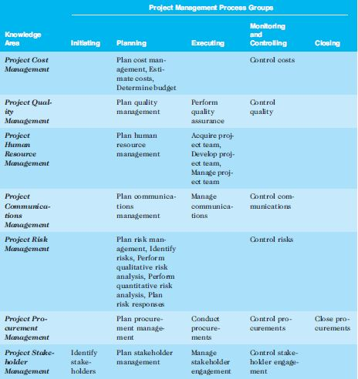
PMI - continued

Slide 15
Project vs. product/service life cycle
Project life cycle:
Start = project initiation phase
End = project closing phase
Product/service life cycle:
Start = product/service Move To Production (MTP)
End = product/service no longer supported (could be months or years after last product/service is created)

Slide 16
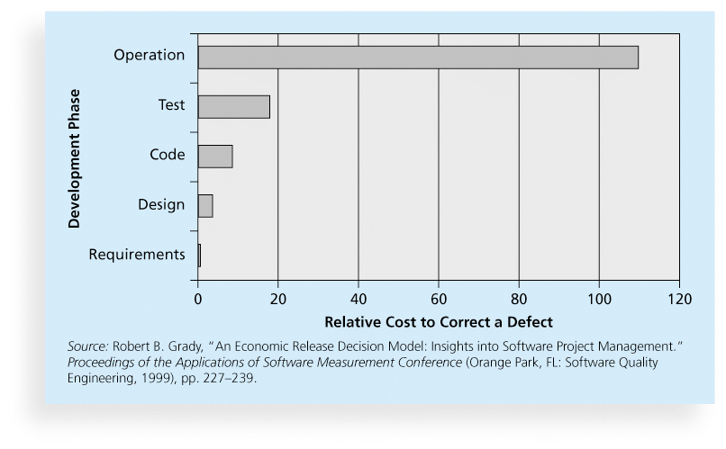
Relative Cost to Correct a Software Requirement Defect

Slide 17
Summary
Project selection phase
Pre-initiation phase
Project Phases
Initiation
Planning
Implementation (Executing)
Monitor and Control
Closing
Project vs. product/service life cycle

Slide 18
Questions?

