Slide 1
Quality Planning

Slide 2
Quality Planning
Definition
Grade
Statistics
Control limits
Normal Distribution
Standard deviation
Quality Planning Tools
Measurement terminology
Tolerances
Defining and meeting client expectations
Quality Assurance

Slide 3
Before we start
During my, Ziko, HP orientation in late 1984, someone said:
“You can’t manage what you don’t measure” and it stuck to my head.
What does the above statement mean?
I have also heard quality experts say:
If you can’t measure it, you can’t improve it!

Slide 4
Definition of Quality
PMBOK Guide V.5:
"Quality - The degree to which a set of inherent characteristics fulfills requirements.
Conformance to requirements: The project’s processes and products meet written specifications
Fitness for use: A product can be used as it was intended

Slide 5
Cost of Quality
The cost of quality is the cost of conformance plus the cost of nonconformance:
Cost of Conformance means delivering products that meet requirements and fitness for use
Cost of nonconformance means taking responsibility for failures or not meeting quality expectations

Slide 6
Grades as a measure of quality
Pre-set standards
Octane rating for gasoline
Horsepower in cars
Lumber graded for appearance, strength
Steel and other commodities

Slide 7
Using statistics to measure and manage quality
Control limits
Upper and lower standards for allowable variation
Central limit theorem
Frequency distribution
Discrete math— “bins” –count the number of measurements that fall in each bin
Normal distribution– “bell-shaped curve”

Slide 8
Measuring your products
Options:
Measure entire population:
When does this make sense?
Sampling
Smaller amount of data to work with:
What is the appropriate percentage?
Sometimes measuring destroys the sample:
Destructive testing

Slide 9
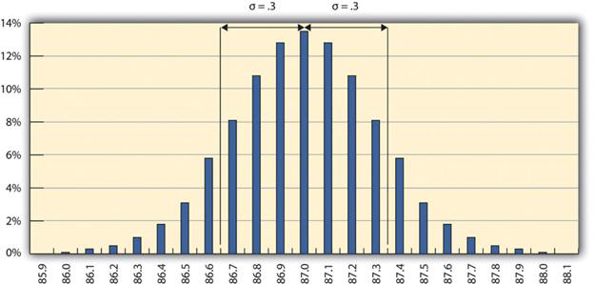
Normal Distribution
Figure 18.2.2 One Sigma Range
Source: http://pm4id.org/10/1/

Slide 10
Normal Distribution
Standard deviation
Calculate the mean (or average value) of all measurements
Subtract EACH measurement from the mean
Square EACH difference
Sum the values
Divide the sum by ( (number of values) – 1 )
Take the square root
Result can be thought of as the average difference

Slide 11
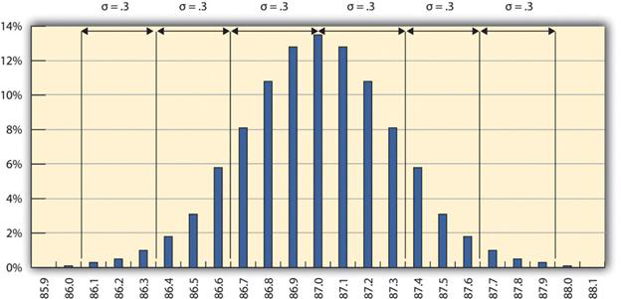
The 68-95-99.7 Rule
Figure 18.2.3 The 68-95-99.7 Rule
Source: http://pm4id.org/10/1/

Slide 12
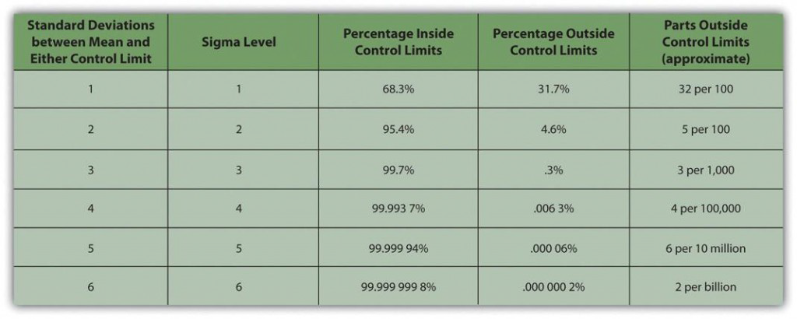
Sigma Levels
Figure 18.2.4 Meaning of Sigma Levels
Source: http://pm4id.org/10/1/

Slide 13
Quality Plan
The quality plan specifies the control limits
Often written as the mean ± the acceptable variation
The size of the range is called the tolerance
May specify material to be used
May include people training
May include quality tools

Slide 14
Quality Assurance (QA)
A program for the systematic monitoring and evaluation of the various aspects of a project, service, or facility to ensure that standards of quality are being met:
Benchmarking: Comparing your product/service/process quality to key competitors
Quality Audit: is the process of systematic examination of a quality system carried out by an internal or external quality auditor or an audit team

Slide 15
Quality Control (QC)
An aggregate of activities (such as design analysis and inspection for defects) designed to ensure adequate quality especially in manufactured products:
Acceptance decisions
Rework
Process adjustments

Slide 16
Quality planning techniques
Cost-benefit analysis
Benchmarking
Experimentation design
Control Charts
Cause and Effect diagrams
Pareto diagram
Flow charts

Slide 17
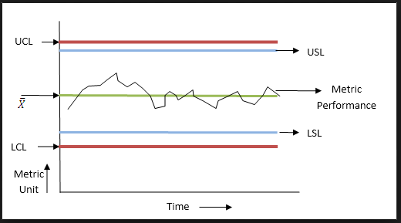
Control Charts (SPC)

Slide 18
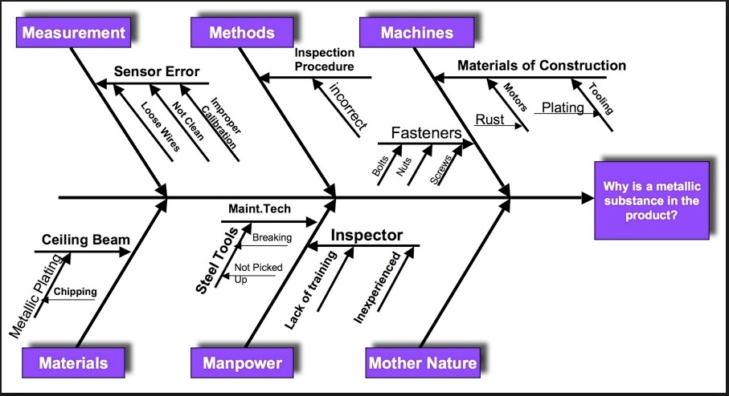
Cause-and-Effect Diagram (aka fishbone diagram)

Slide 19
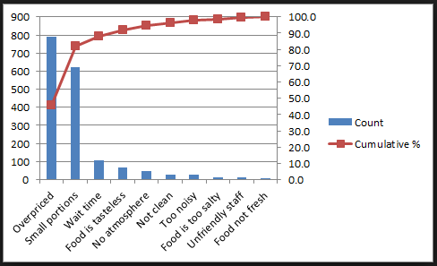
Pareto Chart

Slide 20
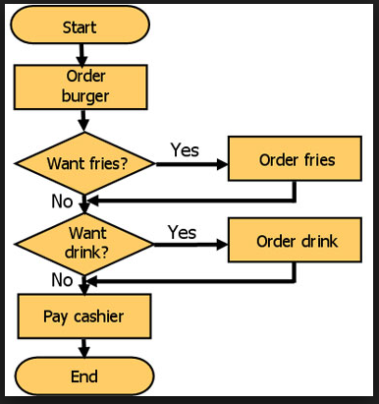
Flow Chart (traditional)

Slide 21
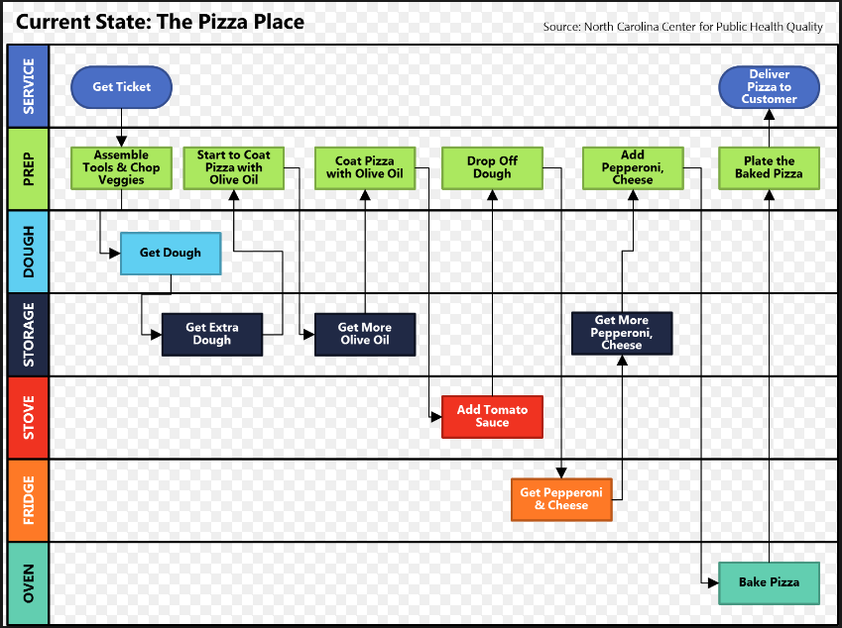
Flow Chart (swim lanes)

Slide 22
TQC/TQM (never ending cycle)

Slide 23
Quality Responsibility
Who is most responsible for quality on a project:
Sponsor?
PM?
Team members?
Who is most responsible for quality in a Company:
CEO?
PMs?
Employees?

Slide 24
Summary
Purpose of Quality Management:
Build confidence in clients that quality standards and procedures are being followed
Ensured by
Internal review of plan
Testing
Revising policies
External Review or audit

Slide 25
Questions?

