Slide 1
CS240B
Week-9 Slides

Slide 2
Firewalls
Firewalls are a network security systems that monitor and control incoming and outgoing data traffic based on predetermined security rules.
Typically, a Firewall establishes a barrier between a trusted network and untrusted external network (i.e. home and Internet).

Slide 3
Firewalls -2
Firewall categorizes:
Network Firewalls:
Filters incoming and outgoing traffic between two or more networks (i.e. subnets) and runs on a network hardware (i.e. router or appliance)
Can not filter on encrypted data (only destination host can decrypt).
Host Firewalls:
Filters incoming and outgoing traffic on a host computer and runs on the those computers
Can filter on encrypted data (decrypted by host).

Slide 4
Firewalls Filtering Criterias
Firewalls can filter on the following criteria:
IP Addresses:
Source and/or destination
Port numbers:
Source and/or destination
Protocols:
TCP, UDP, IP, ICMP, etc.
Applications:
i.e. %ProgramFiles%\google\chrome\application\google.exe
Day/time window (some firewalls):
i.e Permit only on Friday from 1:00 until 1:30 PM Pacific Time.

Slide 5
Firewalls Filtering Criterias - 2
NOTE: In theory, firewalls can filter on any piece of data they have access to (frame, packet, and segment header fields and even unencrypted data):
Frame type:
Ethernet, WIFI, HDLC, ATM, etc.
Ethernet frame header:
Source/destination MAC address
Packet header:
Version = IPv4 or IPv6
Differentiated Services Code Point (DSCP) = Voice, Video, or Data

Slide 6
Firewalls Strategies
Admit all traffic, except {what is blocked in the filters - blacklisted}:
Default outgoing traffic strategy
Block all traffic, except {what is allowed in the filters - whitelisted}:
Default incoming traffic strategy

Slide 7
Types of Firewalls
First Generation: Packet Firewall (a.k.a stateless firewall):
Inspects each incoming/outgoing packet individually
If the packet matches the filter rules, it’s allowed to proceed
If the packet does not match the filer rules:
The packet is dropped (silently)
The packet is dropped and generates an ICMP to sender
Operates at ISO/OSI layers 2, 3 & 4 (frame, packets, and segments).

Slide 8
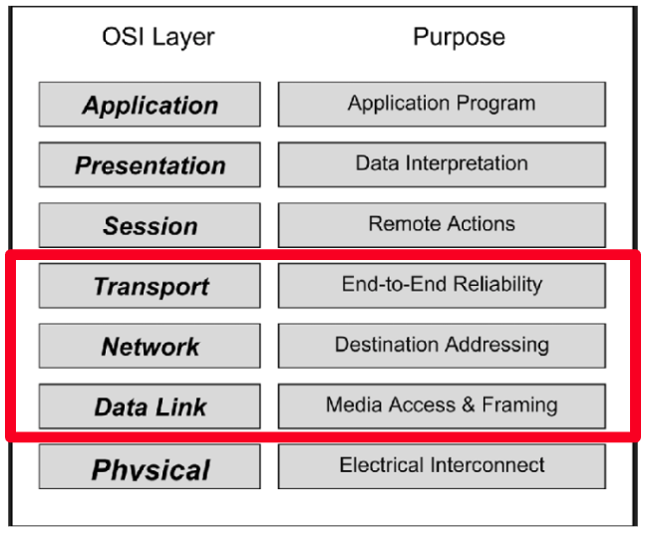
Packet Firewall

Slide 9
Types of Firewalls -2
Second Generation: Stateful Firewall (a.k.a Circuit-Level Gateway):
Perform the work of the Packet Firewalls, PLUS
Keeps track of the state of network connections:
Maintains a table of the active conversations between the endpoints (maintains a static and a dynamic tables)
Requires more system resources than Packet Firewalls
Operates at ISO/OSI layers 2, 3, 4 & 5 (frames, packets, segments, and sessions).

Slide 10
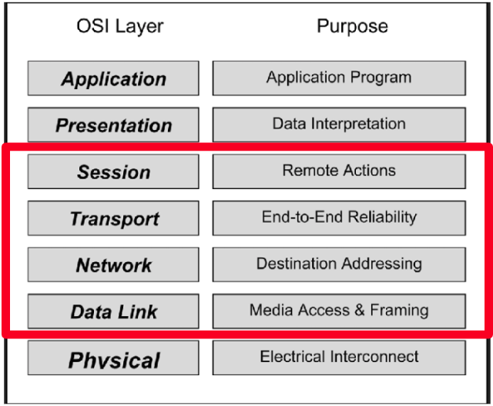
Stateful Firewall

Slide 11
Types of Firewalls - 3
Third Generation: Application Firewall:
Perform the work of the Stateful Firewalls, PLUS
While Stateful Firewall can distinguish between HTTP (port 80) and HTTPs (port 443) traffic, an application-level filter might be able to tell the difference between HTTPS traffic used to access a Web page and HTTPS traffic used for file sharing (much more granular)
Slower than stateful firewalls
Operates at ISO/OSI layers 2, 3, 4, 5, 6 & 7.

Slide 12
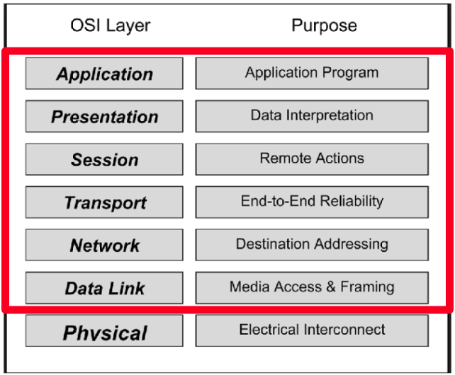
Application Firewall

Slide 13
Types of Firewalls - 4
Proxy Firewall:
Two connections are established: one between the source computer and the firewall, another between the firewall and the destination computer
Application proxies intercept arriving packets on behalf of the destination, examine application payload, and then relay permitted packets to the destination
Suspicious data is dropped
End computers never communicate directly with each other.

Slide 14
Types of Firewalls - 5
Proxy Servers
Over and above Firewall filters, Proxy Servers perform the following functions:
Security/Hides Internal IP address (outside computers see proxy server IP)
Logging (who did what? i.e. who visited which websites)
Cache (i.e. caches recently used websites)

Slide 15
MS Windows Firewalls
MS Windows uses an advanced Stateful and Application Firewall with three different GUIs for different users:
Turn Windows Firewall on or off:
For every day user
Allowed Apps:
For intermediate users
Advanced Settings:
For advanced users
Granular filters.

Slide 16
MS Windows Firewall Profiles
MS Windows Firewall Profiles:
Domain:
Applies when a computer is connected to a corporate domain (Active Directory)
Private:
Applies when a computer is connected to a private network location, such as home (protected by home/enterprise firewall)
Public:
Applies when a computer is connected to a public network location.

Slide 17
Importing and Exporting Firewall Rules
Fine tuning Firewalls is highly skilled work and can be time consuming.
MS Windows Firewall allows one to export and import firewall rules:
Run MS Windows Firewall
Click on “Actions”, then “Export Policy…”
Select drive/folder and enter file name
NOTE: Leave the file extension as “WFW”.

Slide 18
Firewall Rules and GPO
While one can import a Firewall Policy, WFW file, to an individual computer, this model does not scale
A much more efficient method is to use GPO to distribute and maintain Firewall policies.
NOTE: In gpedit.msc, the “Windows Firewall with Advanced Security” settings are found under “Security Settings”.

Slide 19
Demo MS Windows Firewall
Runs MS Windows Firewall:
Let’s take a closer look at the Firewall dashboard
Click on the “Turn Windows Firewall On and Off”:
Talk about the different options
Click on “Allow an app or feature…” :
Talk about the different options
Click on “Advanced Settings”
From the navigation from, Right-click on the “Windows Firewall with Advanced…”, then click on “Properties”:
Talk about each tab
Talk about IPsec tab

Slide 20
Demo MS Windows Firewall - 2
Click on “Outbound Rules”
Click on “New Rule...”:
Explore “Program” options
Explore “Port” Options
Explore “predefined” options
Explore “Custom” options
Exit Windows Firewall

Slide 21
Demo MS Windows Firewall - 3
Create a new outgoing rule to block access to elearning.linnbenton.edu (IP and HTTPS):
First, let make sure we can access “elearning.linnbenton.edu” {should succeed}
Nslookup elearning.linnbenton.edu {write down IPv4 IPs}
Netstat -n {do you see entries for above IPs}
Ipconfig /flushdns {flush DNS entries}
Run MS Windows firewall, Advanced Settings, Outbound Rules, and click on “New Rule…”
Select “Port” Option, and click on “Next”
Select “TCP”, enter “80, 443”, and click on “Next”
Select “Block the connection” and click on “Next”
Select “Domain”, “Private”, and “Public” profiles and click on “Next”
In the “Name:” field, enter “Block Moodle”, and click on “Finish”
What did we just do? Exit, then restart the browser. Can you access any outside HTTPS sites?
Can you still access google.com? If yes, why? {google QUIC}

Slide 22
Demo MS Windows Firewall - 4
Let’s refine the rule to only exclude elearning.linnbenton.edu IPs:
Double-click on The “Block Moodle” rule
Let’s take a closer look at each tab
Click on the “Scope” tab
Enter the elearning.linnbenton.edu IPs in the “Remote IP Address”
Save changes and test {should only block LBCC Moodle}.

