Slide 1
CS240A
Week-10 Slides

Slide 2
Hypervisor or Virtual Machine Manager (VMM)
A hypervisor or Virtual Machine Manager (VMM) is computer software, firmware, or hardware that creates and runs virtual machines.
A computer on which a hypervisor runs one or more virtual machines is called a host machine and each virtual machine is called a guest machine.
The hypervisor presents the guest operating systems with a virtual operating platform and manages the execution of the guest operating systems.
Multiple instances of a variety of operating systems may share the virtualized hardware resources: for example, Linux, Windows, and MacOS instances can all run on a single physical x86 machine.

Slide 3
Windows Hyper-V
Microsoft Hyper-V is a native hypervisor.
It can create virtual machines on x86-64 systems running Windows.
Hyper-V was first released alongside Windows Server 2008.
Available with Windows Server 2012 and Windows 8 Pro and above.
NOTE: Microsoft has a free standalone Windows Hyper-V Server (command line interface only).

Slide 4
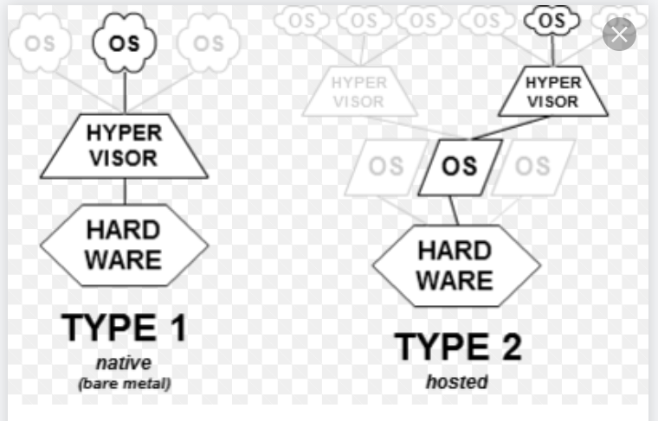
Type-1 and Type-2 Hypervisors

Slide 5
POSE vs. VOSE
POSE = Physical Operating System Environment:
OS running directly on physical hardware.
VOSE = Virtual Operating System Environment:
Virtual Machines.
Please note that VOSEs on the same host don’t know about each other and are protected from one another {they each think they have all the system resources}.
NOTE: From a network point of view, there is no difference between a POSE and VOSE. Almost every server you connect to is a VOSE.

Slide 6
VM Advantages
Much faster Turn-Around-Time (TAT).
Can easily scale VM resources up and down:
To scale up, the host must have the needed resources (CPU, RAM, NIC, and storage).
Cost effective (a high-end physical server can host multiple VMs):
Enables small/medium size companies to dedicate different VM servers for different services.
Enables small/medium size companies to cluster across two high-end physical servers.
Reduces footprint and electricity consumption (fewer physical servers).

Slide 7
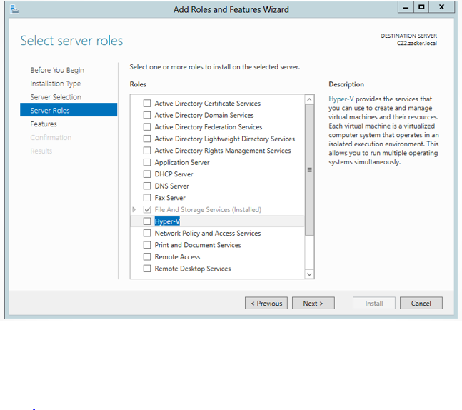
Hyper-V Role

Slide 8
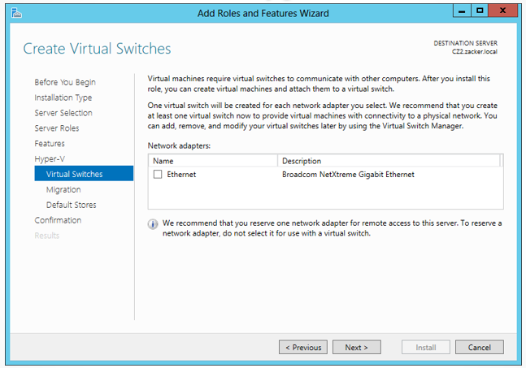
Virtual Switches

Slide 9
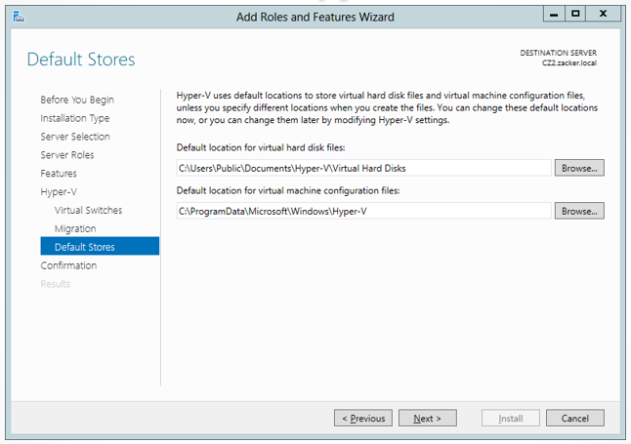
Hyper-V Stores
VMs consist of the
Following files:
VHD
Config Files

Slide 10
Hyper-V VM Files
Virtual Machine Configuration (.VMC) = VM settings.
Virtual Hard Disk (.VHD or .VHDX) = Host OS, Apps, and Data files.
Saved-State (.VSV) = VM placed in saved state.

Slide 11
VHD vs. VHDX
VHD:
2 TB Limit
Backward compatible
VHDX:
Up to 64 TB
Not backward compatible

Slide 12
VHD and VHDX Formats
Fixed Hard Disk = fixed size.
Dynamic Hard Disk = grows up to set limit.
Differencing Hard Disk = child image associated with a parent image (i.e. Multiple Windows Server VMs sharing a common parent OS while each child VM has its own VHD/VHDX) .

Slide 13
VHD Installation Options
Create a new VHD during installation.
Use an existing VHD – I.e. image of existing installation.
Add/Remove VHDs later.

Slide 14
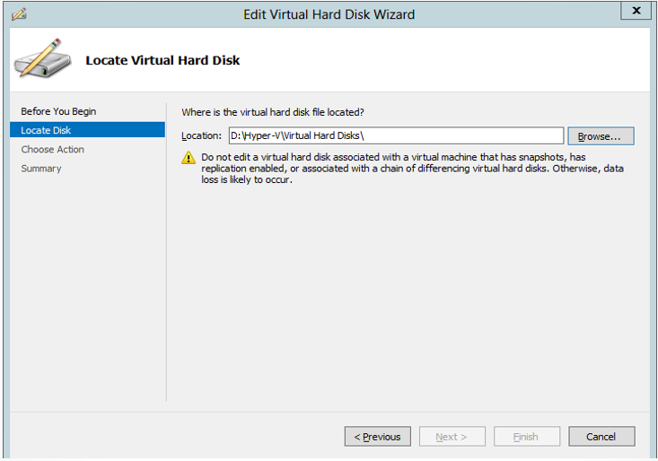
Modify VHD/VHDX

Slide 15
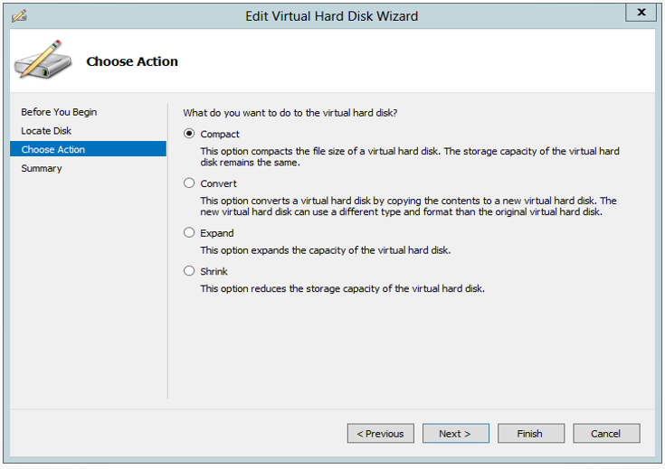
Modify VHD/VHDX - continue

Slide 16
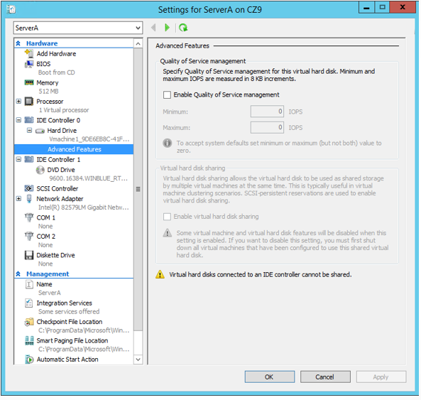
VHD/VHDX Quality Of Service (QoS)

Slide 17
Pass-through Disk
A VM can use an entire physical disk drive.
The drive must be taken offline in the host OS.
The disk can’t be shared with another VM.

Slide 18
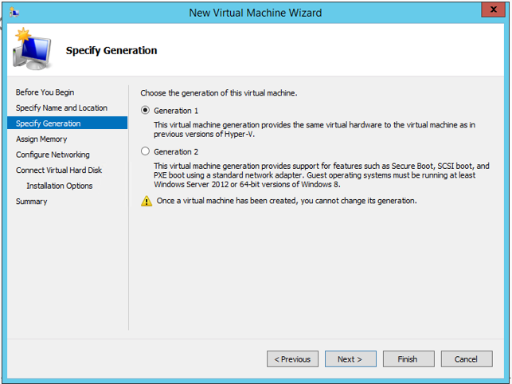
Gen-1 and Gen-2 VMs

Slide 19
Resource Metering
One could use PowerShell cmdlets to track several performance metrics:
CPU
RAM
Disk
Network
NOTE: The above metrics can be used for billing purposes.

Slide 20
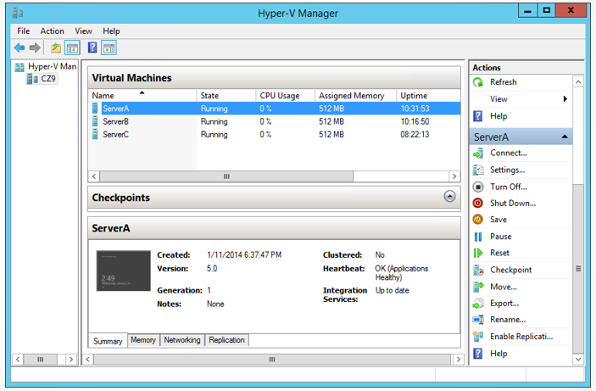
Hyper-V Manager

Slide 21
VMs Hardware Resources
CPUs
RAM
Virtual Network Adapters
Virtual Disks
NOTE: While CPUs, NICs, and Disk Drives can be shared among multiple VMs, once a VM claims it’s portion of the RAM, that portion is no longer available for other VMs.

Slide 22
Hyper-V Checkpoint (formally known as snapshot)
Capture image of the VM state, data, and hardware configuration of a virtual machine at a particular moment in time.
Can capture multiple checkpoints.
Easy method to reverse back to a previous state:
Big deal when upgrading OS, Drivers, Apps, etc.
Snapshot files = .AVHD and .AVHDX.

Slide 23
Sysprep Tool
The System Preparation tool, sysprep.exe, is used to prepare an installation of Windows for imaging or delivery to a customer.
/generalize prepares the Windows installation to be imaged:
All unique system information is removed from the Windows installation
The security ID (SID) resets
Restore points are cleared
Event logs are deleted.
/oobe Out Of Box Experience:
Same process as a brand new PC.
sysprep /generalize /oobe /shutdown
Demo.

Slide 24
Hyper-v failed to add device virtual CD/DVD disk – Error Message
When installing an OS using an ISO file from a remote computer, you will likely run into this error message:
“Hyper-v failed to add device virtual CD/DVD disk”
A known security issues which can be fixed
https://bobcares.com/blog/hyper-v-failed-to-add-device-virtual-cd-dvd-disk/
An easier method is to copy the ISO file(s) to the VM host machine.
NOTE: Will need a minimum of 20GB VHD for Windows installation {40-50 GB is better}.
NOTE: Spring 2022, \\ziko-2019-1\ISO
Account = ISO
PWD = Abcxyz123!

Slide 25
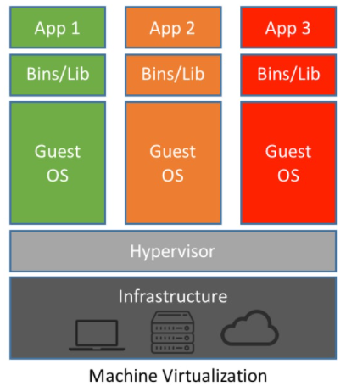
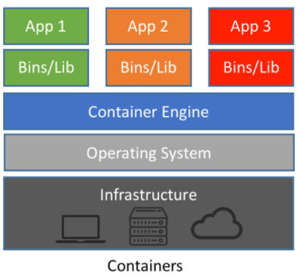
VMs vs. Containers
VMs:
Entire OS environment {large environment which requires more resources}
Almost all services you access today, run on a VM {LinnBenton.edu, Moodle, Amazon.com, Gmail.com, IRS.gov, etc.}.
Containers:
Light OS environment {required app libraries and binaries - fewer resources}
Much better fit for microservices {google and learn about}
Microservices is where the software Industry is at today.
NOTE: Windows Server 2016 & later support OS and Hyper-V containers.
NOTE: Docker is a Platform-as-a-Service {PaaS} product that use OS-level virtualization to deliver software in packages called containers {Container Engine}.

