Slide 1
CS240A
Week-7 Slides

Slide 2
Active Directory Benefits
Single-Sign-On (SSO)
Domain Local and Global groups
Group Policy (GP)
Global Catalog (GC)

Slide 3
Group Policy (GP)
Centralized management of:
Server computers
Client computers
User accounts
Benefits = Increase ROI & decrease TCO
Over 1,000 operating system and user settings can be set and managed centrally
Group policies can be set for:
Site {IP-subnet based}
Domain {all OUs and nested OUs}
OU {cascade down the child OUs}
Local computer {server or client}

Slide 4
Group Policy - 2
Group Policy settings are stored in Group Policy Objects (GPO)
GPOs can be local or non-local:
Local = apply to local computer (Server or PC)
Non-Local = apply to sites, domains and OUs
When multiple GPOs are present, they are applied in this order (LSDOU):
Local GPO first
Site GPO(s)
Domain GPO(s)
OU GPO(s) last
NOTE: The LSDOU order is very important!

Slide 5
Group Policy - 3
Computer GPOs will implemented during computer startup (or by using the gpupdate command)
User GPOs will be implemented during user logon (or by using the gpupdate command)
When multiple GPOs are present, the later GPO(s) policies will override the previous GPO(s) policies:
Unless the previous policies were “Enforced”
When Group Policy Objects are updated, the old policies will be removed or updated (duh)

Slide 6
Group Policy Tools
One could use the Group Policy tools in Server Manager or MMC snap-ins
Group Policy Management Console (GPMC):
Single admin tool for managing Group Policy across enterprise
GPMC is used to create and manage GPOs
Group Policy Object Editor:
Used to configure and modify settings inside GPOs (part of GPMC)
Local Group Policy Editor:
To manage local Group Policy Objects

Slide 7
Group Policy Linked
After a GPO is created, an administrator can link to a Site, Domain or OU
Multiple GPOs can be linked to a single Site, Domain and/or OU

Slide 8
Group Policy Settings

Slide 9
GPO Refresh

Slide 10
Group Policy Commands
Gpupdate /?
Gpresult /?
Gpedit.msc

Slide 11
GP & MSI Packages
MSI = Microsoft Installation:
According to wikipedia, MSI is a software component used for the installation, maintenance, and removal of software on modern Microsoft Windows systems
Many/Most of the applications on your PC were deployed using MSI packages – search your c: drive for “.msi”
One could manually run an MSI package to install software
One could also use Group Policy to install MSI packages

Slide 12
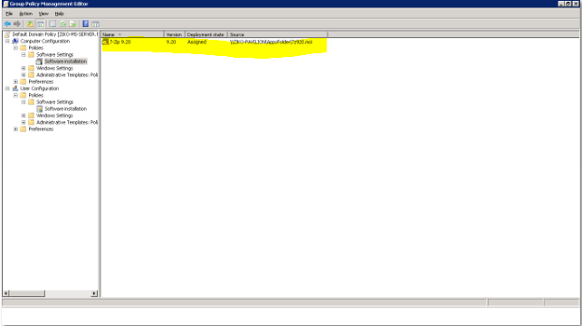
GP & MSI Packages - 2
IMPORTANT: If the MSI package is going to generate prompt screens, i.e. UAC, then you’ll need to suppress these prompt screens using a GPO.

Slide 13
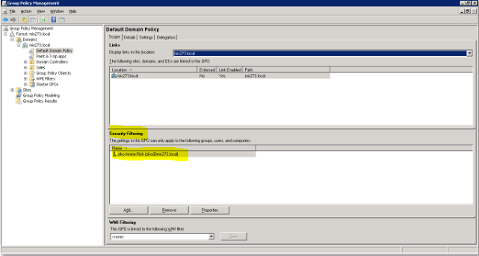
Security Filtering
The GPO scope could be set using user(s) and/or group(s) filter:

Slide 14
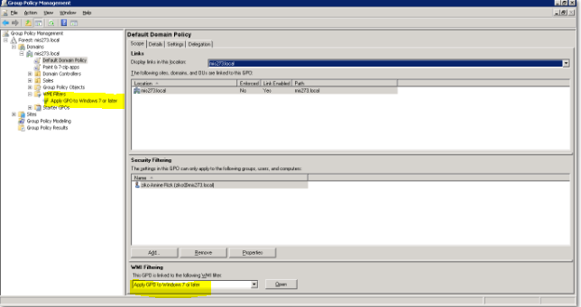
WMI Filtering
The GPO scope could be set using Windows Management Instrumentation (WMI) filter:
For example, apply GPO only to Windows 7 clients

Slide 15
WMI Filtering - 2
Only target computers running Windows XP Professional:
Root\CimV2; Select * from Win32_OperatingSystem where Caption = "Microsoft Windows XP Professional"
Assign software only on computers already having either of two software packages:
Root\cimv2;Select * from Win32_Product where name = "MSIPackage1" OR name = "MSIPackage2"
Target Toshiba Tecra models 800:
Root\CimV2se
Apply a policy on computers that have a specific hotfix:
Root\cimv2 ; Select * from Win32_QuickFixEngineering where HotFixID = 'q147222‘
NOTE: For many more WMI examples, google “group policy WMI”

Slide 16
Group Policy and Computer Folder
If the computer object is created during the join process, the computer object will be created inside the Computers folder
Group Policy Objects, GPO, will not apply to computers inside the Computers folder.
NOTE: On the hand, the default Domain Controllers is an OU (GPOs can be linked to OUs).

Slide 17
GP Best Practices
Ziko’s #1 GP advice = as is the case with all powerful tools, use with extreme caution! One small GP mistake will cost you a lot - asking for forgiveness is never a good strategy-;)
A good test environment/lab is a must!
Carefully test all GPOs before deployment – no matter how simple, you think, the GP settings are
Where possible, for each GPO you develop and test, develop and test a rollback GPO

Slide 18
GP Best Practices - 2
Don’t use a single GPO for all settings:
It’s much cleaner to use different GPOs for different settings/purposes
It’s okay to have multiple GPOs per container
Don’t apply the same GPO to multiple layers of the same hierarchy:
I.E. apply same GPO at domain, and OU inside the domain and another OU inside the previous OU
Don’t use GP for what it was not designed for:
I have been in meetings where some admin would recommend a GP fix regardless what the problem is
PLEASE, don’t do that!

Slide 19
GP Best Practices - 3
Use “Enforced” sparingly
Use “Block Inheritance” more sparingly
Minimize the use of WMI filters
NOTE: IF you want to learn more, just google “group policy best practices”
NOTE: You can also check out this link on Group Policy best practices -
http://windowsitpro.com/group-policy/group-policy-design-best-practices

Slide 20
Summary
Group Policy is one of many excellent IT tools
Always use the best tool for the job
For app deployment and inventory = Microsft System Center (MSC)
An excellent test environment that captures all biz variations is a must!
Thoroughly test all GPOs before deploying!

