Slide 1
CS240A
Week-4 Slides

Slide 2
What is a Directory?
A Directory is a database
Yellow and White pages are directories
So is a Domain Name Server (DNS)
A Network directory contains objects: user accounts, groups, computers, printers, file shares, etc.
Users and computers can use and query the directory database
There are several network directories in use today:
Active Directory is just one implementation (a very popular implementation)

Slide 3
What is Active Directory (AD)?
Microsoft’s implementation of a Network Directory
Windows NT Domain Controllers (NT DC) were Microsoft’s first Network Directory (version 1.0)
Windows AD came out with Windows 2000
Windows AD is by far the most popular Network Directory in use today
I have heard & read that Windows AD is the heart and the brains of a Microsoft-based ecosystem:
Critical to successful deployment and management of Windows-based ecosystem!

Slide 4
AD Leaf Objects?
User accounts (i.e. Ziko)
Security and distribution groups (i.e. ProjectX):
Security groups are used with Access Control Lists (ACLs)
Distribution groups are used with email
Computers (i.e. Ziko-PC, FileServer-04, MSExchange-05):
In order for the user/computer to use AD objects, the computer must be a member of the AD or trusted AD {more on trust later}
Shared drive (i.e. \\FileServer-04\C$)
Shared folders (i.e. \\FileServer-04\projectx)
Printers (i.e. \\PrintServer-02\Bld10LJ)
Applications

Slide 5
What are the benefits of AD?
Single-Sign-On (SSO) - #1 benefit:
Logon once and roam inside AD Forest and trusted Forests (one day, I hope we will all have have a SSO in cyberspace)
In other words, you will be auto-magically authenticated by all computers inside the AD forest and trusted forests
Global/Universal groups - #2 benefit:
Use global/universal groups to manage files/folders/file-shares/printers ACLs
Group Policy - #3 benefit:
Centralized computer and user management (i.e. set Password and Account Lockout policies on all computers, remove Control Panel from manufacturing floor PCs, configure the new LaserJet printer on all building 5 PCs, etc.)

Slide 6
AD Dimensions/Domains
Logical:
Along business lines to support business objectives (no regard to network topology) – maps to the organization chart
More on this later
Physical:
If the business operates at multiple locations with slower links connecting the different locations, then the AD design and construction must support the business while factoring in the network topology
More on this later
NOTE: LBCC is a good example where logical and physical dimensions must be factored into the AD design.

Slide 7
AD Schema
Defines the AD objects and information pertaining to those objects (attributes)
Each AD object has:
Unique Name
Globally Unique Identifier (GUID) – 128-bits hex
Attributes - divided into two camps:
Required (i.e. user first and last names)
Optional (i.e. user cell phone number)
Each attribute has a version number and date when it was created and modified
NOTE: AD schema can be extended/modified.

Slide 8
AD Global Catalog (GC)
The GC stores information about every object within a Forest (more about Forests soon)
The first Domain Controller (DC) configured in a forest becomes the GC server
GC serves the following purposes:
Authenticate users when they logon
Providing lookup and access to all resources/objects/leafs in all domains
Providing replication of Active Directory elements
Keeping a copy of most user attributes for each object

Slide 9
AD & DNS
AD uses DNS to resolve the AD domain name(s) to IP(s)
One can install DNS on the same server as AD:
Will do this in this class
One can configure the AD to use an existing DNS
This is what happens in the real world

Slide 10
AD Containers
AD has a treelike structure:
Similar to the hierarchy of folders
AD Structure affects how you manage security:
Delegate some admin role to different users that can wear the admin hat
The AD hieratical elements/contains {Become comfortable with containers}:
Forest
Tree
Domain
Organization Unit (OU)
NOTE: A server that hosts a Domain is called a Domain Controllers (DC).

Slide 11
AD Forest
Highest-level in AD design
A forest consists of one or more AD Trees that are in a common relationship and have the following characterizes:
AD Trees can use disjointed namespace:
One Forest could have zikotravel.com & zikoweb.com Trees
All AD Trees use the same schema
All AD Trees use the same Global Catalog
Domains enable administration of commonly associated objects within a Forest (more on Domains later)
A two-way transitive trust is automatically configured between Domains inside a Forest (more on trusts later)

Slide 12
AD Forest - continue
NOTE: When the first Domain in an Active Directory is created, a new tree and forest are created, and that first domain becomes the tree root domain and forest root domain.

Slide 13
AD Tree
An AD Tree contains one or more Domains that are in a common relationship and have the following characteristics:
Domains must use contiguous namespace and can be in a hierarchy:
Domains can have child Domains (i.e. zikoweb.com & design.zikoweb.com and support.zikoweb.com)
A two-way transitive trust is automatically configured between parent and child Domains
All Domains in a single Tree use the same schema
All Domains use the same Global Catalog

Slide 14
AD Domain
Logical partition within an AD Forest
Grouping of objects/leafs within an AD Forest
Basic functions of AD Domain:
AD Partition in which to house objects/leafs:
Accounts & Groups/Dist-Lists
Drive and folder shares
Computers and printers
To establish a set of instructions to be replicated from one DC to another
To expedite management of a set of objects

Slide 15
AD Domain - continue
AD is a distributed database, multi-master Domain Controllers:
For example, in a 5 DC environment, 5 servers hosting the same Domain database, system administrators could add users or groups to any one of the 5 DCs and the information will be replicated to the other 4 DCs
NOTE: Multi-master means all Domains are equal. No master-slave or primary-backup relationship which existed in NT Domain Controllers.

Slide 16
AD Organization Unit (OU)
A method to achieve more flexibility in managing resources
OUs allow the grouping of objects so they can be administered using the same Group Policies
OUs enable server administration to be delegated or decentralized
OUs can be used to reflect the structure of the organization:
Inside a Domain container, one could have an OU for each functional area (i.e. Sales) and sub-OUs for each department inside Sales (i.e. West-Sales, East-Sales, etc.)
Map to the enterprise Org Chart

Slide 17
AD Sites
A Site is a TCP/IP-based concept (container) within AD that is linked to the IP subnets and has the following function:
Reflects one or more subnets (usually with good network connectivity):
i.e. LBCC Albany, Lebanon, and Corvallis campuses
Reflects the physical aspect of the network
Is used for DC replication
Is used to enable a client to access the DC that is physically closest
Is composed of only two types of objects, servers and configuration objects

Slide 18
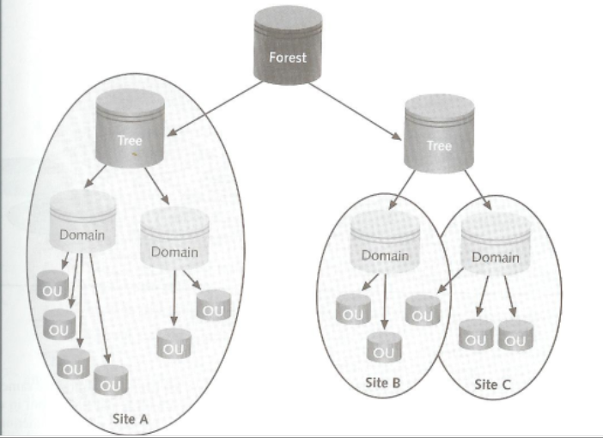
AD Containers

Slide 19
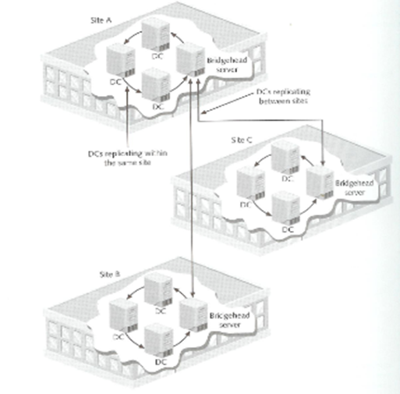
AD on Multiple Sites

Slide 20
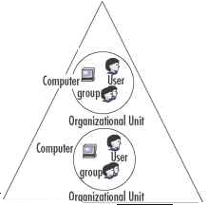
Active Directory Structure
zikoco.com Forest
xyzco.com Forest
zikoco.com
Forest & Tree Root
xyzco.com
Forest & Tree Root
sueco.com
Tree Root
abcco.com
Tree root
europe.zikoco.com
Child
americas.xyzco.com
Child
asia.sueco.com
Child
canada.americas.xyzco.com
Child
Two-way Transitive Trust
In order for asia.sueco.com to authenticate objects in europe.zikoco.com, the request has to go up from child to root and back down to child.
One can speed the authentication process by creating a manual direct trust between asia and euope domains.
If zikoco.com and xyzco.com need to collaborate:
Two-way trust between the two domain domains (the transitive nature will establish trust with children)
One-way trust between the two domain (if zikoco.com wants to trust xyzco.com and not the other way around).
Domain content

Slide 21
Read-Only Domain Controllers (RODC)
Normal DCs replicate information to one another:
Multi-master DCs
RODC is read-only:
Good fit for sites/locations that have no system administration (i.e. small/remote sales offices, etc.)
Unable to create new objects/leaves

Slide 22
Functional Levels
The multiple Domain Controllers (DCs) for a single forest could be installed on different servers running different versions of Windows Server (i.e. Windows Server 2012, 2016, and 2019)
Functional levels are designed to provide backwards compatibility (With Domain Controllers (DCs) running various versions of the Windows Server operating system
NOTE: By selecting the functional level representing the oldest Windows version running on your domain controllers, you disable the new features so that the various domain controllers can interoperate properly.

Slide 23
AD Design Guidelines
As you can imagine, AD design can easily get very complicated
The #1 guideline is: Keep It Simple!
Use the least number of Forests and Trees – with one Tree-Forest being the ideal
Use the least number of Domains possible – with one Domain being the ideal
Create only the number of OUs that are absolutely necessary

Slide 24
AD Examples
Small company
Medium company/school (i.e. LBCC, LaneCC, etc.)
Large company/government (i.e. Google, Amazon, etc.)

Slide 25
AD Examples – GM.COM
GM:
Chevy
Buick
Cadillac
Options:
One-tree forest with a single domain:
GM.COM {simplest design, but may not meet biz needs}
One-tree forest with three child domains:
GM.COM, Chevy.GM.COM, Buick.GM.COM, & Cadillac.GM.COM {two-way implicit transitive trust}
Four-tree forest:
GM.COM, Chevy.COM, Buick.COM, & Cadillac.COM {two-way implicit transitive trust}
Four forests:
GM.COM, Chevy.COM, Buick.COM, & Cadillac.COM {no implicit trust, but can be explicitly/manually created}

