Slide 1
CS240A
Week-3 Slides

Slide 2
Domain Name Service (DNS)
In a TCP/IP network, one must use the IP address of the destination computer to communicate (IP being the end-to-end address)
To simplify the use of TCP/IP networks, users can enter the Fully-Qualified-Domain-Name (FQDN) of the destination computer (i.e. www.facebook.com, www.linnbenton.edu, www.whitehouse.gov, etc.)
In fact, users don’t have to type the www before the domain name (i.e. facebook.com, linnbenton.edu, etc.):
The application (i.e. web browser) will default to WWW
The process of resolving a FQDN to an IP address is called Name Resolution

Slide 3
Domain Name Service (DNS)
DNS is a directory service that resolves a FQDN to an IP, and if a reverse lookup zone is available, resolve an IP to a FQDN
DNS supports IPv4 and IPv6 Name Resolution
In fact, one could argue that the need for DNS is even greater with IPv6 (where the IP addresses are much longer, use hexadecimal numbering, and use a different display format from IPv4 addresses)

Slide 4
The Hosts File
In the early days of TCP/IP networks, the World Wide DNS Infrastructure did not exist, and we used the c:\windows\system32\drivers\etc\hosts file to resolve host names to IPs
As TCP/IP usage grew, it became very clear that the flat Hosts file structure has two major issues:
Scale - could not possibly support the amazing growth of the Internet
Slow to update - the traditional daily Hosts file update is much too slow
NOTE: The Hosts file is still around and one could use it. Just remember:
The Hosts file entries will be cached into RAM and used first
One needs Administrator privileges to modify the Hosts file

Slide 5
Why DNS?
The World Wide DNS infrastructure was designed to address the two major issues with the Hosts file:
Scale - Because of DNS’ distributed World Wide structure, stay tuned, it’s highly scalable (Cisco expects 50 Billion TCP/IP devices by 2020)
Update Cycle - Because each organization is responsible for keeping it’s DNS records up-to-date, stay tuned, the update cycle is very short

Slide 6
DNS Elements
DNS consists of three elements:
The DNS Name Space
Name Servers (NS)
Resolvers

Slide 7
DNS Name Space
The DNS World Wide infrastructure is an upside-down tree where each tree branch is a Domain (i.e. google.com, linnbenton.edu, irs.gov, etc.)
Each Domain is a collection of Resource Records which contain a FQDN, IP, and other information (let's call it a Domain table or database)
Resolvers query the domain database for information (retrieve specific record. I.e. www.linnbenton.edu from linnebnton.com DNS)

Slide 8
DNS Name Server (NS)
The DNS NS is a computer running the DNS Application/Service and maintains information about the domain tree structure and contains authoritative information about one or more specific Domains
The DNS NS responds to queries about the Domain(s) for which it has the authority and forwards queries about other Domains (i.e. the linnbenton.edu DNS NS will respond to linnbenton.edu Domain queries and forward queries about other Domains)
This enables any DNS server to access information about any other Domain in the World Wide DNS infrastructure

Slide 9
DNS Resolver
The Resolver is a program that generates a DNS query and sends to a DNS server to service
A resolver must have access to at least one DNS server (either configured statically or dynamically)
NOTE: Use ipconfig /all command and look for the DNS IP(s).

Slide 10
DNS Start Of Authority (SOA)
A start of authority (SOA) record includes administrative information about your zone, as defined by the domain name system (DNS). Anytime you set up a new zone, you'll need a new SOA record. And any time you transfer one DNS zone to another, you'll need that record too.
Zone IP address {i.e. linnbenton.edu}.

Slide 11
DNS Naming
Two-tier naming system:
Domain name (i.e. linnbenton.edu, google.com, irs.gov, etc.)
Host name (i.e. www, ftp, email, etc.)
The FQDN = Host name + Domain name (i.e. www.linnbenton.edu., ftp.microsoft.com., etc.)
NOTE: Almost always, the www host name is an alias.
NOTE: The FQDN is resolved backward - starting with the dot at the far end which refers to the top-level domain.

Slide 12
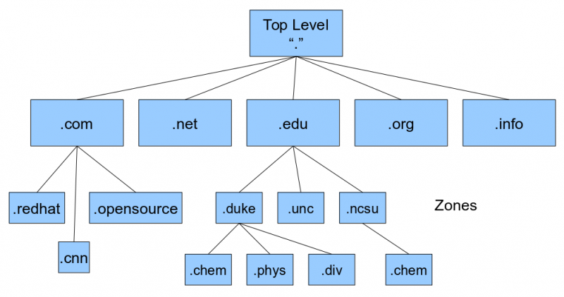
DNS Naming Hierarchy - www.root-servers.org
Root
TLD
2nd-LD
3rd-LD

Slide 13
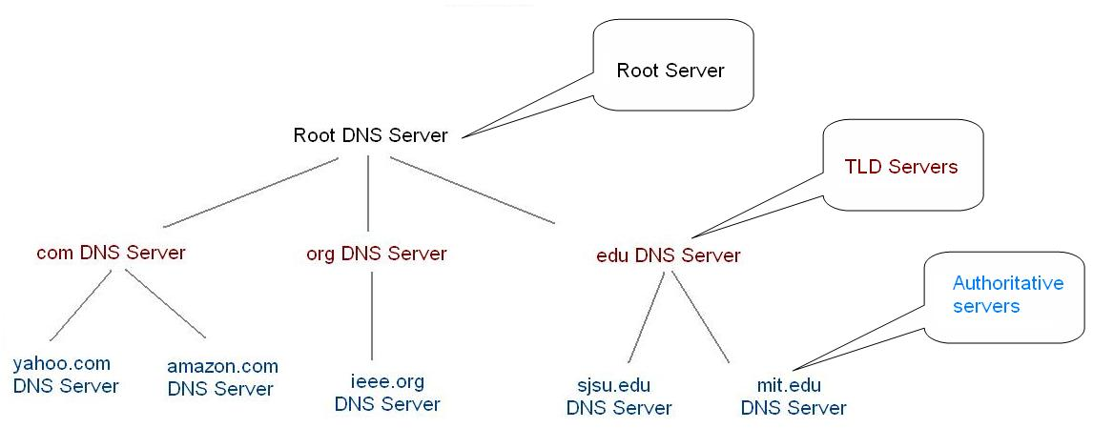
DNS Naming Hierarchy - www.root-servers.org

Slide 14
DNS Referrals
The process DNS servers request Name Resolution from each other is called Referrals. There are two type of referrals:
Recursive = The DNS server takes full responsibility for resolving the host name. Often, Recursive DNS servers make multiple round-trips before replying back to the Resolver. i.e, typically, the client configured DNS server(s) are Recursive servers.
Iterative = The DNS server will immediately reply the best information it has at the time. This could be cached or authoritative information or the IP address of another DNS server. This is the process DNS servers communicate with each other.

Slide 15
How Does DNS Work?
Let’s say I run Chrome and type facebook.com, what happens:
Chrome will fully qualify the destination host name = www.facebook.com.
The Resolver will check local cache for www.facebook.com. , if found, use IP, done
The Resolver will query the configured DNS for www.facebook.com.
Configured DNS will check its cache first, if found return IP, done
Configured DNS will query a root DNS NS, for .com DNS IP
Configured DNS will query .com DNS NS for facebook.com DNS IP
Configured DNS will query facebook.com DNS NS for www.facebook.com, which should have the proper IP(s) and return to the requesting DNS
Configured DNS will return the www.facebook.com IP(s) to resolver

Slide 16
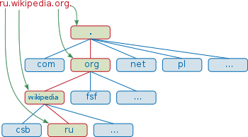
FQDN Mappings

Slide 17
Standalone DNS vs. Install with Active Directory
DNS can be installed and configured as a standalone service (There are several DNS solutions in the market with different added features):
DNS records will be stored in a flat file - %SystemRoot%\System32\DNS\
DNS records are not encrypted - security issues
DNS UPdates are not encrypted - security issues
DNS can also be installed along with Active Directory:
The DNS Records are stored in the Active Directory database and are encrypted
The DNS updates are a part of the Active Directory updates and are encrypted

Slide 18
Other DNS Terms
Reverse Lookup Zone = Resolve a an IP to a FQDN
Negative Caching = The cached DNS record is no longer correct
DNS Forwarder = If the DNS record is not found locally, forward the request to another DNS server
TTL (Time-To-Live) = Amount of time, in seconds, the record will stay cached (the TTS value is configured at the authoritative NS)
PTR (Pointer) = Address-to-Name mapping - used with reverse lookup
CNAME (Canonical Name) = An alias that points to the canonical name (i.e. the real host name)
Round Robin = when a single host name has multiple IPs, shift the IP order by one (inexpensive and effective load balancing technique)

Slide 19
DNS, DHCP, and Dynamic DNS (DDNS)
WHat do you want to happen when a client obtains a new DHCP IP? Is it important that the DNS record is updated to reflect the new IP?
If no, then no need to integrate DHCP with DNS
If yes, then one must integrate DHCP with DNS:
There are no free lunches!
Before integrating DHCP with DNS, one must do a CBA {Cost-Benefits Analysis}
In a nutshell, is it worth the effort?
Ziko says, almost always no

Slide 20
Dynamic DNS (DDNS) - Continues
With the amazing growth of the Internet-of-Things (IoT), many people have a need to access a home device (i.e. WAP, Camera, Fridge, etc.)
ISP’s uses DHCP to assign your home Wireless Access Point (WAP) an IP address
One could use their home WAP IP address to connect remotely; however, the DHCP IP may change and the IP address is hard to remember
One way to address both of the above issues is to use a cloud DDNS service (i.e. dyndns.com):
Assign your home IP a name (zikohome.dyndns.com)
Configure your home device (i.e. WAP) to update the cloud DNS with the current IP address (look for DDNS option)

Slide 21
NetBIOS Host Name
Windows clients have two host names:
FQDN (i.e. stevepc.linnbenton.edu.) - use hosts file or DNS to resolve
NetBIOS name (i.e. stevepc) - use lmhosts, WINS, or broadcast to resolve (in this order)
NOTE: Similar to the hosts entries, the lmhosts entries are cached.
NetBIOS host names are used with SMB/CIFS type services
WINS = Windows Internet Name Services:
Effectively, WINS is to NetBIOS is what DNS is to FQDN
While Windows still support WINS, most enterprises no longer use (legacy)
NOTE: NetBIOS names must be unique on the same subnet.
DEMO: Show lmhosts and IPv4 WINS configs.

Slide 22
NetBIOS Over TCP/IP (NBT)
In the good old days before TCP/IP was the undisputed king of network protocol suits, Microsoft used the NetBIOS/NetBEUI protocol suite:
NetBIOS the higher layers (application layer)
NetBEUI the lower layers
NetBEUI did not work across LANs (subnet specific = serious limitation)
Some legacy applications are still using the legacy NetBIOS API
NetBIOS over TCP/IP enables the legacy NetBIOS API to work over the TCP/IP protocol, extending the reach of NetBIOS client and server programs to the IP internetworks and providing interoperability with various other operating systems
DEMO: Show IPv4 NBT configs.

