Slide 1
CS240B
Week-1 Slides

Slide 2
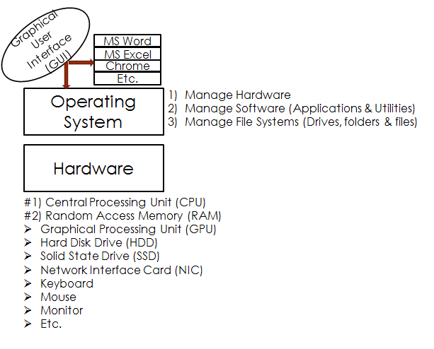
Still High-Level Computer Abstraction

Slide 3
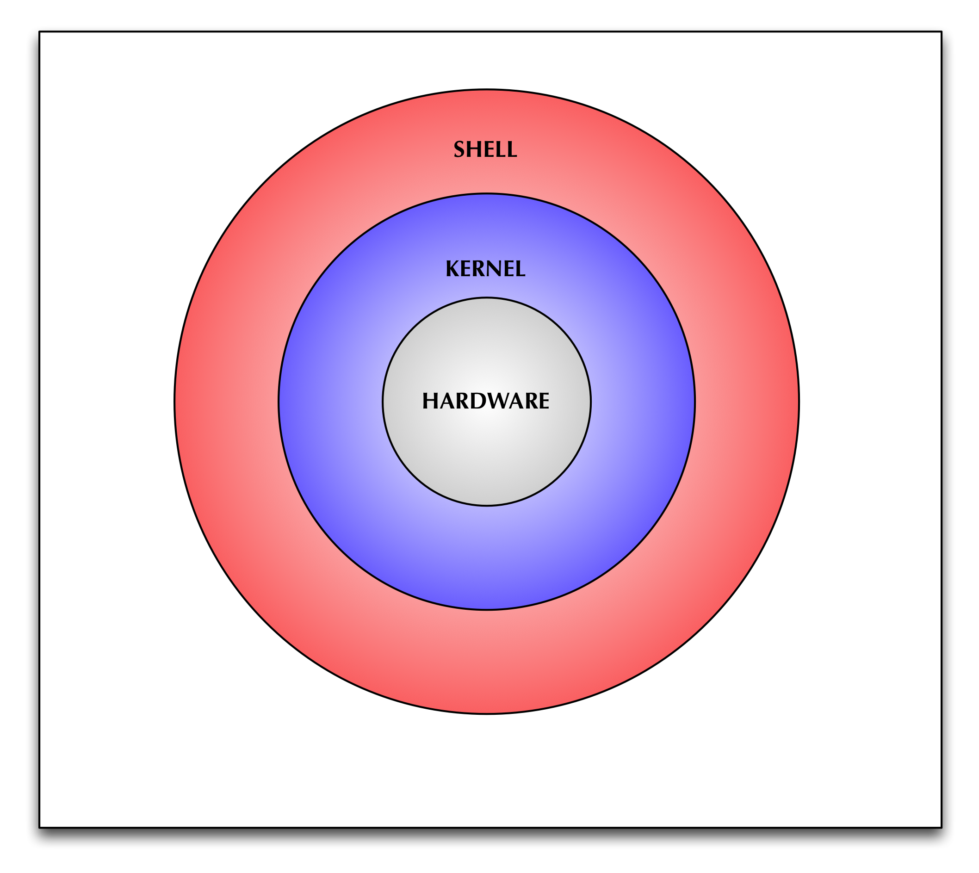
High-Level Computer Abstraction

Slide 4
What Do OSs Do?
Manage and abstract hardware (including CPU, RAM, storage, and peripherals)
Manage and arbitrates apps (multiple users and apps)
Manage file system (storage)
Manage shells (CLI and/or GUI)
Manage I/Os
Manage security (protection/ACL and security against attacks)
OS = A program that enables the user to run their apps and manage their files (easily and securely).

Slide 5
OSs Market Shares
Laptops/Desktops:
MS Windows (> 80%)
OS/X - Unix-based (< 5-6%)
Chrome - i.e. Chromebook (<6-7%)
Linux (1-2%)
Tables/Smartphones:
Android - Linux-based (> 80%)
IOS (< 20%)
Servers:
Linux (many flavors)
Unix (Many flavors)
Windows Server
Autonomous Computers (cars, space crafts, etc.):
Real Time OSs (RTLinux, VxWorks, etc.)
Many other specialized OSs

Slide 6
Modern OSs
Modern OSs share a great deal with each other:
64-bit, multi-user, preemptive multitasking, symmetric multiprocessors (SMP), multi-threaded, multi-modes (kernel and user), multi-language (unicode), secure file system, TCP/IP support, PnP support, many admin utilities, etc.
Otherwise, they would no longer be popular.
Question: why do we have so many OSs?

Slide 7
Windows Server 2019
Microsoft's Enterprise-level Server
Windows Server 2019 Editions:
Edition | Ideal For | VMs | RAM Limit | CPUs
Essential | Small business or department with no VMs | None | 64 GB | 2 CPUs
Standard | Advanced capabilities with limited VMs | 2 | 24 TB | 64 sockets/ 512 core (i.e quad or octa)
Data Center | Advanced capabilities with many VMs | Unlimited | 24 TB | 64 sockets/ 512 core

Slide 8
Windows Server Core
The Server Core option is a minimal installation option, no Desktop GUI, that is available when you are deploying the Standard or Datacenter edition of Windows Server.
Server Core requires fewer resources and has a smaller disk footprint, and therefore a smaller attack surface due to a smaller code base.
For example, Windows Server Core is an excellent fit for a Physical Operating System Environment, POSE, host whose primary job is to create VMs (Virtual Operating System Environment, VOSE).

Slide 9
Windows Server 2019 vs. Windows 10/11
In a nutshell:
Windows Server Scale:
Windows 10/11 does not scale to enterprise level (i.e. CPUs, RAM, Storage Options, Clustering, max number of concurrent users, etc.)
Windows Server Services:
Windows 10/11 does not provide enterprise services (next few slides)
While Windows 10/11 is optimized for foreground applications (i.e. browser, Word Process, Game, etc.) Windows Server is optimized for background services (Active Directory, DNS, DHCP, File Share, etc.)

Slide 10
Windows Server 2019 Roles
Server Roles:
Describe the primary function, purpose, or use of a computer. A specific computer can be dedicated to perform a single role that is heavily used in the enterprise, or may perform multiple roles if each role is only lightly used in the enterprise. I.e. Active Directory, DNS, etc.
They provide users throughout an organization access to resources managed by other computers, such as Web sites, printers, or files that are stored on different computers.
They typically include their own databases.

Slide 11
Windows Server 2019 Features
Server Features:
Features are software programs that, although they are not directly parts of roles, can support or augment the functionality of one or more roles, or improve the functionality of the server, regardless of which roles are installed. For example, the Failover Clustering feature augments the functionality of other roles, such as File Services and DHCP Server, by allowing them to join server clusters for increased redundancy and improved performance.
NOTE: Logon to Windows Server 2019 and demo Roles and Features.

Slide 12
Windows Server 2019
Three basic categories of server roles:
Directory services:
Store, organize, and supply information about a network and its resources (i.e. Active Directory)
Infrastructure services:
Provide support services for network clients (i.e. DHCP, DNS, Hyper-V, Remote Access, etc.)
Application services:
Provide communication services, operating environments, or programming interfaces for specific applications (i.e. Applications, IIS/Web, File and Storage, Print, etc.)

Slide 13
Windows Server 2019 Directory Services
Active Directory Certificate Services
Active Directory Domain Services (AD DS)
Active Directory Federation Services
Active Directory Lightweight Directory Services (AD LDS)
Active Directory Rights Management Services (AD RMS)

Slide 14
Windows Server 2019 Infrastructure Services
DHCP (Dynamic Host Configuration Protocol)
DNS (Domain Name System)
Hyper-V
Network Policy and Access Services (NPAS)
Health Registration Authority (HRA)
Remote Access
Volume Activation Services
Windows Deployment Services (WDS)
Windows Server Update Services (WSUS)

Slide 15
Windows Server 2019 Application Services
Application Server
Fax Server
File and Storage Services
Print and Document Services
Remote Desktop Services (RDS)
Web Server (IIS)

Slide 16
A Few Words About Server Hardware
Before purchasing server hardware, one must answer the following questions:
Which services will this server support, how many concurrent users to support, and what are the business and technical requirements?
POSE or VOSE?
CPU requirements?
RAM requirements?
Storage requirements?
Network requirements?
Cluster requirements?
Can we host at AWS, Azure, etc? Of course, one could start with this question?

Slide 17
Windows Server Core or Desktop Experience?
While the Windows Server Desktop Experience, Windows 10 look-n-feel, is visually pleasant and easier for most to use, it consumes valuable system resources and enlarges the attack surface.
Enterprise servers dedicated for 1-2 services (Hyper-V, Active Directory, DNS, DHCP, etc.) are advised to use Core installation.
NOTE: One could always add and/or remove the Desktop Experience from an existing Windows Server.
NOTE: PowerShell CmdLets can perform all GUI capabilities (and much more).
NOTE: For learning purposes, this course, Desktop Experience installation is a better fit.

Slide 18
Windows Server 2019 Installation
Windows Server 2019 Installation Options:
Clean Installation:
Highly recommended!
Upgrade an Existing Installation:
Avoid! Don’t do it! In my opinion, one must have a strong reason for wanting to upgrade and existing OS Environment.
NOTE: One could use the Windows Server Migration Tools to move the Windows Server roles from an older or unstable server to a newer or stable server (Clean Install and Migrate, instead of Upgrade).

Slide 19
Immediately After the Installation
Assign the Server a static IP, SM, DG, and DNS
Change the default Computer Name (reboot)
Disable IE Enhanced Security Configuration
Enable Remote Desktop
Install anti-malware, configure firewall, and other security services
Join the proper domain (if applicable) (reboot)
Test!

Slide 20
Stuff from CS240A
gpedit.msc
gpupdate /?
gpresult /?
repadmin /?
NOTE: To add a new Tree to a Forest, one must first create the DNS zone {I.e., CS240B20.COM}.
NOTE: To add a Child-Ttree to a tree, no need to add a DNS Zone {will use the parent DNS zone}.

