Slide 1
CS240A
Week-9 Slides

Slide 2
Part-1 = File and Share Management

Slide 3
Authentication and Authorization - Review
Authentication = The OS needs to know who the user is:
Account name
Single or multi-factor authentication:
Password, biometric, and/or token authentication.
Authorization = The OS determines what the user is allowed and not allowed to do:
OS uses the user account and object (folder, file, printer, etc.) ACL:
Each object has an Access Control List (ACL)
The ACL consists of one or more Access Control Entries (ACE).
NOTE: Talk about single factor and multi-factor authentication.
NOTE: Let’s take a quick look at C:\ ACLs and ACEs. Then, format a USB drive as NTFS and look ACLs and ACEs.

Slide 4
MS Windows Authentication Uses Kerberos
Kerberos is a computer network authentication protocol that works on the basis of tickets to allow nodes communicating over a non-secure network to prove their identity to one another in a secure manner. The protocol was named after the character Kerberos from Greek mythology, the ferocious three-headed guard dog of Hades. Its designers aimed it primarily at a client–server model and it provides mutual authentication—both the user and the server verify each other's identity. Kerberos protocol messages are protected against eavesdropping and replay attacks.
Kerberos builds on symmetric key cryptography and requires a trusted third party, and optionally may use public-key cryptography during certain phases of authentication. Kerberos uses UDP port 88 by default.

Slide 5
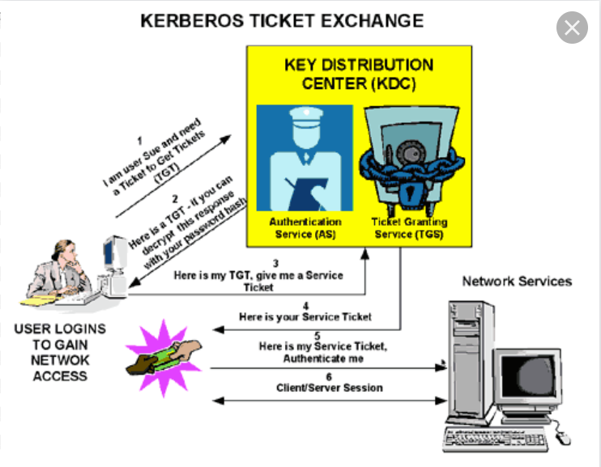
Kerberos Authentication

Slide 6
Local vs. Active Directory Accounts and Groups
MS Windows is a multi-user Operating System
Each MS Windows instance (except for Domain Controllers) includes a local Security Account Management (SAM) database
The SAM database includes all local Accounts and Groups
One can access the SAM GUI by navigating the Windows menus or by running lusrmgr.msc program
The scope of the local SAM Accounts and Groups is the local computer
As we discussed earlier, Active Directory elevates the scope of Accounts and Groups to the enterprise (company-wide)

Slide 7
Windows Access/Security Token - Review
When a user logs onto Windows (local or domain account), Windows creates an Access/Security Token for the user
The token is used for authentication and authorization purposes
The access/Security Token includes:
The account SID
The groups the user belongs to SID
The session SID
NOTE: Demo whoami /? And whoami /groups.
NOTE: Talk about Access/Security Token caching.

Slide 8
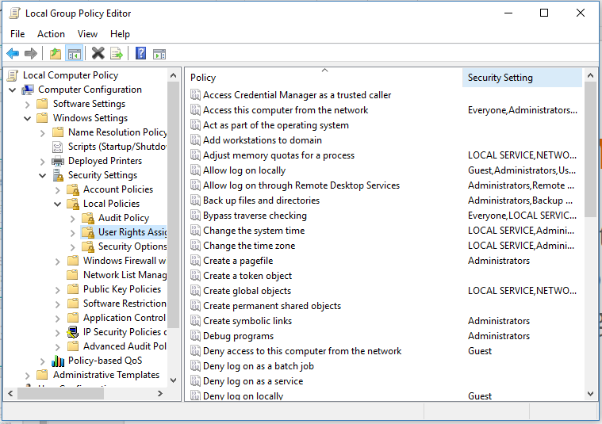
User Rights Assignment Policy - Review
Rights = the OS rights, specific accounts and groups have
NOTE: Pay special attention to Administrator and Administrators, Guest and Guests, etc. (user vs. group).
NOTE: gpedit.msc will run Local Group Policy Editor (not available on Home editions). Let’s take a closer look (do you see the user Administrator? Why not?).

Slide 9
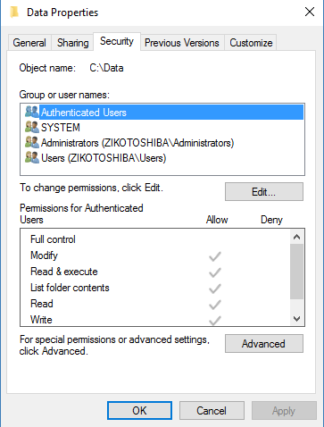
Windows Special Identity Groups
One can’t create, modify, or delete Special Identity groups:
Implicit use = during logon Ziko becomes a member of Authenticated Users
Explicit use = add Authenticated Users group in ACLs/ACEs
The Everyone, Authenticated Users, Creator Owner, and others are Special Identity groups:
System = has same privileges as Administrator and used by OS and services
Everyone = everyone logged on to the system (includes the Guest account)
Authenticated users = everyone logged on to the system with a valid account (excludes the Guest account).
NOTE: When examining ACLs, you’ll likely see Special Identity Groups like Authenticated Users or Everyone (don’t let that confuse you).

Slide 10
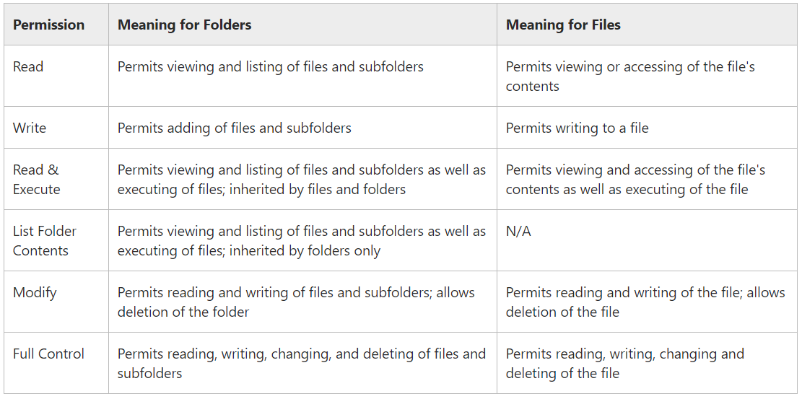
NTFS File and Folder Permissions

Slide 11
NTFS Additive Permissions
NTFS permissions are additive:
For example:
Ziko is a member of Project-ABC and Project-XYZ groups
Project-ABC is granted Read access to C:\Data and Project-XYZ is granted Write access to C:\Data
Ziko will have Read and Write access to C:\Data (additive permission).
The exception to the additive rule is deny:
Deny will override granted permissions
For example (using above example):
Ziko is also a member of TroubleMakers group
TroubleMakers is Denied Write access to C:\Data
Ziko will only have Read access to C:\Data.

Slide 12
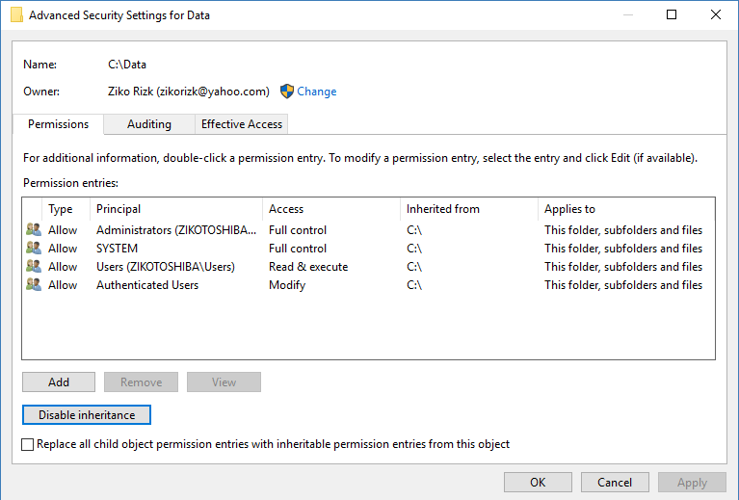
NTFS Inheritance Permissions
No one should have to manage NTFS Permissions for each folder and file individually (too much work!)
To simplify/streamline the process, new folders and files inherit their parent permissions:
Let’s take a look at C:\ permissions, then create c:\Data, then create c:\Data\Test.docs
A user with Full Control permission can change the permissions of a folder or file (this is a must on a shared system).
NOTE: Create C:\Public and change permissions so Everyone group has Read, write, Execute capabilities and TroubleMakers are denied write capabilities.

Slide 13
Folder/File Owner
Each Folder and File have an Owner
The Owner could be an account or group
The Owner can change permissions
NOTE: The Administrator can take ownership of a folder/file and change permissions (sometimes, this is necessary and a part of an administrator job) :
Companies take file/folder security seriously! Administrators have been fired for taking ownership of files/files or changing file/folder permissions unlawfully.
System logging will capture who did what to files/folders. Can’t argue with log files.
NOTE: Format a USB drive as NTFS, then change the root folder ownership to Administrator user.

Slide 14
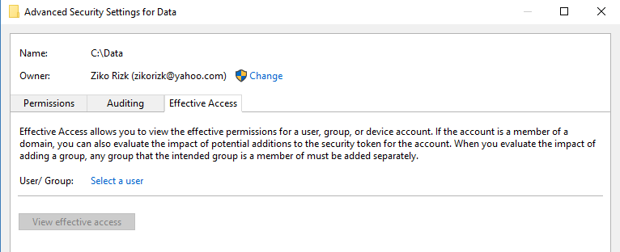
Effective Access
An ACL may contain multiple groups and individual accounts with different permissions:
With NTFS additive and deny permissions, it could be complicated and confusing to find out the Effective Access for a single user or group
For this reason, Windows includes an Effective Access option.
NOTE: Show user Ziko Effective Access to c:\Public folder.

Slide 15
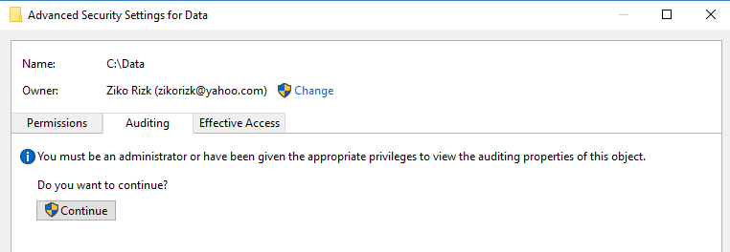
Folder/File Auditing
Auditing is a method to keep track of who did what to specific folders/files
We will cover Auditing in more details later in CS240B.
NOTE: In order for auditing to work, the SACL and GP must be configured.

Slide 16
Basic and Advanced NTFS Security
Basic = Keep It Simple - for the masses:
I believe NTFS permissions are still too complex and confusing to the masses. This is why Microsoft streamlined the NTFS permissions so the average user does not have to change or worry about.
Advanced = For advanced users with fine grain granularity:
Take ownership
Delete inherited permissions
Auditing
Effective Access.
NOTE: Show C:\Data basic and advanced security.

Slide 17
Folder/File Permissions - Lab
Experiment with C:\Data:
Create C:\Data\Home and C:\Data\school subfolders
Add 1-2 files in each of the above two new folders
Take Ownership of C:\Data, give to local Administrator and propagate
Delete inherited permissions and assign new NTFS permissions to C:\Data and propagate:
Give Authenticated Users group Read access
Give Administrators group Full Control
Deny TroubleMakers group any access
Check results
Use Effective Access on C:\Data with Ziko, Guest, and TroubeMakers
etc.

Slide 18
Shared Folder Permissions
To make a folder accessible to other users and groups over the network, one must use the Network File and Folder Sharing option
When sharing a folder, one must also specify the shared folder permissions
When accessing a shared folder over the network, the user will go through two gates or layers of security:
The shared folder permissions
The NTFS folder/file permissions
When accessing a folder or file over the network, the most restrictive permissions will apply.
NOTE: This is where many users get confused. I have Full Control to the file, but I can’t modify?

Slide 19
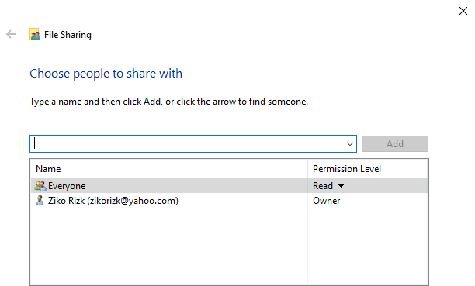
Shared Folder Permissions - continues
For example:
C:\Data folder NTFS permissions give Ziko user Full control
C:\Data folder is shared and the share permissions give Everyone group Read access:
When Ziko is logged on to the system directly, Ziko has Full Control access to C:\Data folder
When Ziko is accessing C:\Data using the shared folder over the network, Ziko has Read access to C:\Data folder (most restrictive).

Slide 20
Basic and Advanced Shared Folder Security
Basic = Keep It Simple - for the masses:
Remember the two gates of security (NTFS and Shared Folder).
Advanced = For advanced users with fine grain granularity:
Multiple shares to same folder (different permissions)
Set maximum number of concurrent users
Caching.
NOTE: There are legitimate business reasons for having different NTFS and Shared Folder permissions. As long as you understand the limitations, you are okay.
NOTE: Show C:\Data Shared Folder basic and advanced security.

Slide 21
Shared Folder - Lab
Modify C:\Data NTFS permissions to give Authenticated Users Read, Read & Execute, and List Folder access
Share C:\Data and give Everyone Full Control permission
Ask students to connect to \\instructor-ip\data
Which user did they use logon to instructor PC?
Can they logon as a different user?
What privileges do they have? why?
NOTEs:
Are the classroom computers members of the same Domain?
Is Guest enabled on Instructor computer?

Slide 22
Part-2 = Print and Doc Management

Slide 23
Windows Print Architecture
Print Device = The actual hardware (what you and I call printer):
Local - connected to computer
Network-based
Printer = The software interface (printer configuration)
Print Server = Manages the print jobs
Print Driver = A device driver

Slide 24
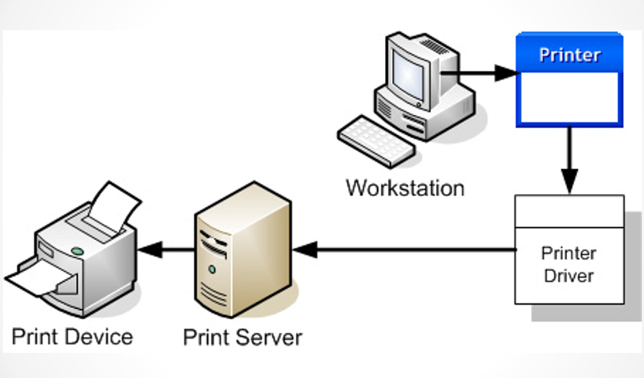
Windows Print Architecture - continue

Slide 25
Print Devices
Local = Connected to computer:
Could be shared with others (using SMB/CIFS)
Network-based = Connected to network:
Individual computers could configure and use (no print server)
Managed by print server and shared

Slide 26
Sharing a Printer
On a PC, one could use Device and Printers:
Add a printer
Printer Servers will use Print Management utils
The Print Management util is also available on PCs

Slide 27
Print and Document Service Role
Please install the Print and Document Service Role

Slide 28
Print Management Util Options
Could use one printer (SW configs) for multiple print devices:
Publishing house (lots of printing)
Could use multiple printers (SW configs) for a single print device
Different SW configs ( higher priority, different paper, etc)
Filter using specific criteria:
Show jammed printers, low ink, no paper, etc.

Slide 29
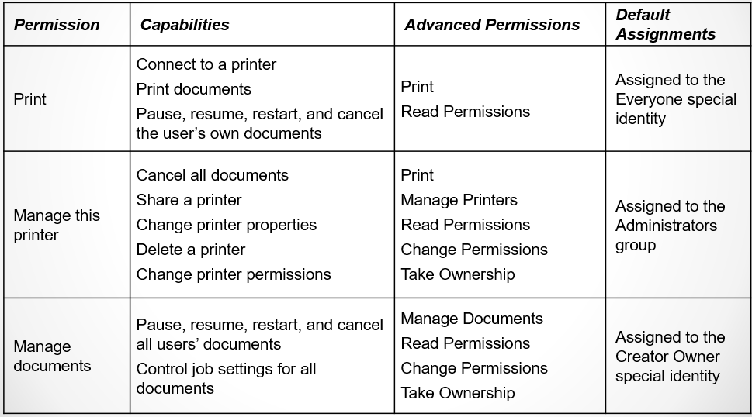
Printer Permissions

Slide 30
Demo Print Management Util
One printer (SW configs) for multiple print devices
Multiple printers (SW configs) for a single print device
Filter using specific criteria

Slide 31
Deploying Printers with Group Policy
Demo

