Slide 1
CS240A
Week-8 Slides

Slide 2
Before we Start
In the good-old days, data storage was physically attached to the server hosting the service(s). This model has several serious issues:
If the server went down, which they all do, the users loose access to the service(s) and data
If IT moves a service to a different server {i.e. server scheduled downtime or load-balancing}, IT would also have to move the data {think big data = slow}.
In the new brave world of massive worldwide services {i.e. gmail, facebook, amazon, etc.} and virtualization {where the VM could/does move from one physical server to another}, the good-old model is unacceptable!
Modern IT decouples the data from the physical box and stores the data in a Storage Area Network (SAN) accessible to all servers over the network. Of course, we still need local storage for the OS & services (tiny), but not the data. Advantages:
Data is available from any server, POSE or VOSE, over the network
The user could logon to any service front-end server and access their data {we all do each day}.

Slide 3
Before we Start – 2
Today’s HW {computers, peripherals, and storage} are relatively cheap:
In 1985, I bought my first PC w/dot-matrix printer for $3500. In 2023 money = $9,731.37.
Would you pay $9,731 for an average PC w/printer today?
Definitely not! Should cost less than $500.
Today, one could buy 8 TB unit for about $100. In the early 1990s, 1 MB of storage costed about $1.00. Using this math:
1 GB is about $1,000
1 TB is about $1,000,000 {multiply by 8 for 8 TBs}.
I’m impressing you with my historical data to make a very important point: Hardware is cheap! IT staff are not cheap!
Modern IT invests in good & reliable ecosystem {HW, SW, Services, etc.} that requires less IT staff to maintain.

Slide 4
Planning Storage
Capacity requirements (i.e. GBs, TBs, etc.)
Performance requirements (i.e. HDD, SSD, onsite, offsite, etc.)
Data classification/sensitivity requirements (i.e. Top Secret, Secret, Confidential, etc.)
Up-time requirements (i.e. Mission Critical, Entity Essential, etc.):
For Mission Critical services, most IT enterprises use server clusters and mirrored SANs across geographies.
Future growth.

Slide 5
PC/Server Primary Storage Model
File System
-FAT
-NTFS
Disk Type
-Basic
-Dynamic
Partition Table
-MBR
-GPT
Disk Controller
-Firmware (on disk drive, OS communicates with
firmware, using driver, and firmware does I/O)
Non-Volatile Storage
-HDD, SSD, or Hybrid

Slide 6
MBR vs. GPT
MBR (Master Boot Record):
Around since 1983
Supports up to 2 TB partitions (drive can be larger, but only 2 TB will be used):
MBR uses 32-bit partition table index
2**32 * 512B = 2TBs
Supports up to 4 primary partitions (can add non-bootable extended partitions)
MBR partition table is stored in the boot sector located at the beginning of a drive (one copy, if corrupted, trouble)
UEFI CAN’T boot from MBR partition (only BIOS) .
GPT (Guid Partition Table):
Relatively new
Supports large volumes:
GPT used 64-bit volume table index
2 ** 64 * 512B = 9.4 ZB (OS limit is much lower. Windows server 18EB)
MS Windows supports up to 128 primary partitions
GPT partition data is stored in multiple locations across the disk (more resilient, better recovery)
UEFI can ONLY boot from GPT partition
Not supported by older Windows OSs (32-bit XP and earlier).

Slide 7
Basic vs. Dynamic Disks
Basic Disks:
Most often used in Windows
Often uses MBR and works with GPT
Supports primary and extended partitions
Easy to convert to Dynamic Disk and keep data:
Will loose multi-boot
Always wise to backup first
Simple storage:
Shrink partitions
Extend partitions to adjacent unallocated space (can’t extend partitions across physical drives).
Dynamic Disks:
Provides features that basic disks don’t
Can use MBR or GPT
Only MS Windows support!
Does not support removable, USB, FireWire, and SCSI drives
Supported volumes:
Simple
Spanned {extend to other drives}
Striped without parity = RAID-0
Mirrored = RAID-1
Striped with parity = RAID-5
Can be composed of noncontiguous extends on one or more physical disks
Designed for Windows Servers.

Slide 8
Basic Vs. Dynamic - Lab
Demo Basic options:
Shrink
Extend (only to adjacent space)
Demo Dynamic options:
Spanned
Striped (Raid-0)
Mirrored (RAID-1) - requires two disks
Stripped with Parity (RAID-5) - requires a min of 3 disks

Slide 9
Diskpart Utility
Diskpart = command-line disk partitioning utility (Disk Management uses)
Diskpart replaced the older fdisk utility
Diskpart is a powerful tool and a must know for system administrators
Diskpart can be accessed during Windows installation (Shift-F10 to open a DOS prompt, then type diskpart)
DEMO: Open a Windows prompt with Admin privileges, run diskpart, then type ? (scan the long list of capabilities).
DEMO: Insert a USB drive, type list disk, type select disk %USB-disk%, then type clean. View USB drive from File Explorer. Can you access or format? If not, continue with diskpart:
create partition primary
assign letter=f
format fs=ntfs label=”CS240A” quick

Slide 10
FAT32 vs. NTFS - Focus for next week
FAT32:
Not as reliable as NTFS
4 GB file size limit (movie files?)
2 TB max volume
No security
No encryption
No compression
No disk quotas
NOTE: Compatible w/multiple OSs.
NTFS:
Reliable (journaling file system)
Allows large file size (in theory, 2**64. OS limit is much lower)
Allows large volumes w/GPT
Secure (ACLs/ACEs)
Encryption
Compression
Disk quotas
NOTE: Used by Microsoft OSs.

Slide 11
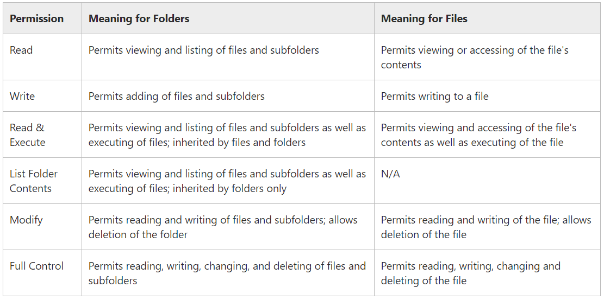
NTFS File and Folder Permissions

Slide 12
NTFS Additive Permissions
NTFS permissions are additive:
For example:
Ziko is a member of Project-ABC and Project-XYZ groups
Project-ABC is granted Read access to C:\Data and Project-XYZ is granted Write access to C:\Data
Ziko will have Read and Write access to C:\Data (additive permission).
The exception to the additive rule is deny:
Deny will override granted permissions
For example (using above example):
Ziko is also a member of TroubleMakers group
TroubleMakers is Denied Write access to C:\Data
Ziko will only have Read access to C:\Data.

Slide 13
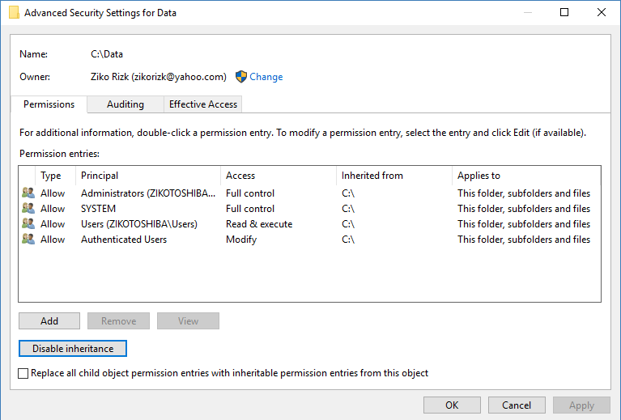
NTFS Inheritance Permissions
No one should have to manage NTFS Permissions for each folder and file individually (too much work!)
To simplify/streamline the process, new folders and files inherit their parent permissions:
Let’s take a look at C:\ permissions, then create c:\Data, then create c:\Data\Test.docs
A user with Full Control permission can change the permissions of a folder or file (this is a must on a shared system).
NOTE: Create C:\Public and change permissions so Everyone group has Read, write, Execute capabilities and TroubleMakers are denied write capabilities.

Slide 14
Virtual Hard Disks (VHDs)
A Virtual Hard Disk (VHD) is a what the description states - Virtual Hard Disk
A VHD is a file that looks like and acts like a physical drive
Hyper-V relies on the VHD format to store virtual disk data in files that can easily be transferred from one computer to another:
When creating a Virtual MAchine (VM), one can create a new VHD or use an existing one
A dismounted/detached VHD can be moved or copied as needed
One can also use the Disk Management or DISKPART utilities to create, attach, and format a VHD

Slide 15
Virtual Hard Disks (VHDs) - Lab
Create a C:\VHD folder - to hold VHD files
Use Disk Management, or DISKPART, and create two VHD files (1024 MB, VHD format, and Fixed) :
C:\VHD\VHD-File-1.VHD
c:\VHD\VHD-File-2.VHD
Initialize and format disks:
C:\VHD\VHD-File-1.VHD as MBR, format as NTFS, and assign drive letter
c:\VHD\VHD-File-2.VHD as GPT, format as NTFS, and don’t assign a drive letter or path (will mount on next slide)
NOTE: Discuss VHD options and Detach.

Slide 16
Mounting a Drive
Traditionally, MS Windows assigned each drive a letter name (A:, B:, C:, etc.)
The more drives the user accesses, the more confusing the letters become
One elegant solution is to mount drives on an empty folder on the primary drive (i.e. instead of Z: drive, the user will see C:\Payroll Data instead)
NOTE: Mountain drives has always been the norm in Unix and Linux Operating Systems.

Slide 17
Mounting a Drive - Lab
Create C:\Payroll folder
Use Disk Management to mount the VHD-File-2 drive, we created earlier, to C:\Payroll
NOTE: Discuss the three VHD drive options:
Assign drive letter
Mount to an empty NTFS folder
Neither (not accessible)

Slide 18
Windows Resilient File System (ReFS)
The Resilient File System (ReFS) is Microsoft's newest file system, designed to maximize data availability, scale efficiently to large data sets across diverse workloads, and provide data integrity by means of resiliency to corruption.
It seeks to address an expanding set of storage scenarios and establish a foundation for future innovations.

Slide 19
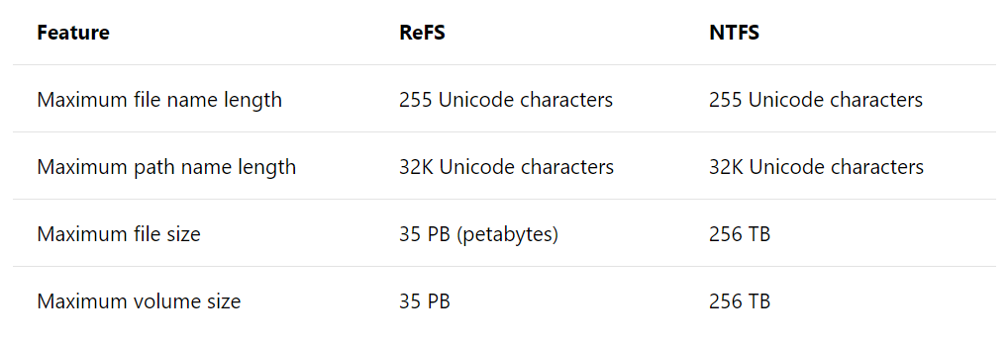
ReFS vs. NTFS Capacity

Slide 20
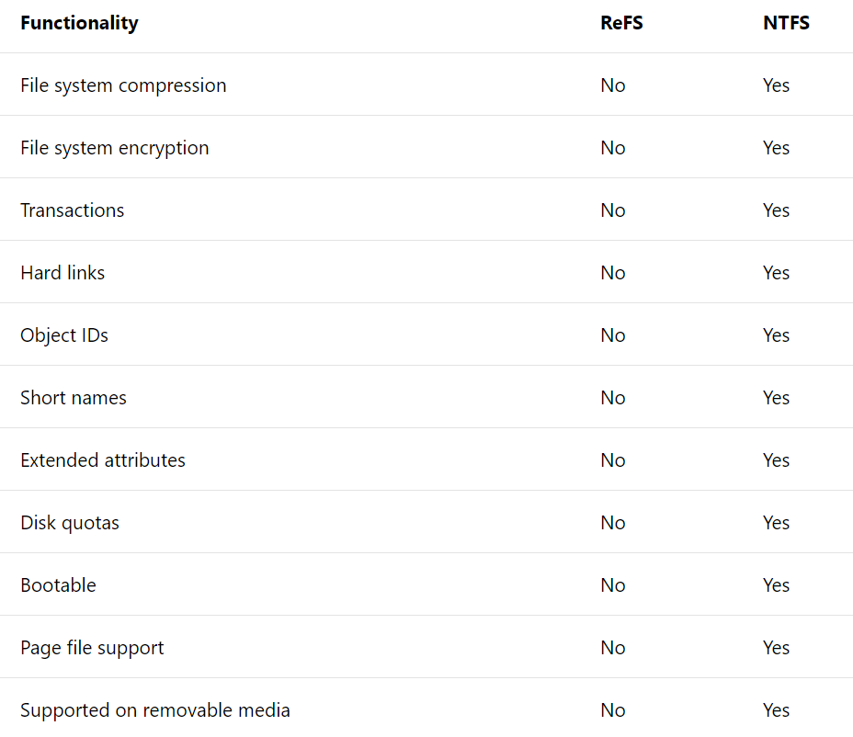
ReFS Vs. NTFS - 2
NOTE: ReFS does
Not support
Compression, encryption, Disk Quotas, Removable Media, and Bootable.

Slide 21
Local Storage Vs. Network Storage
Servers require at least some attached storage (boot the OS)
After that, most IT organizations use Storage Area Networks (SAN) for application and data storage
SANs have several huge advantages over attached storage:
Decouples storage from servers (Multiple servers have access to SAN)
Capacity limitation (servers have limited expansion capabilities)

Slide 22
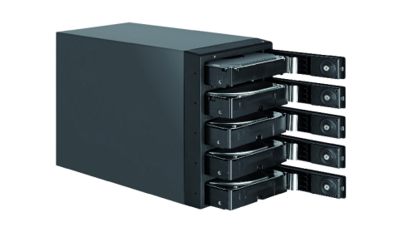
RAID (Redundant Array of Independent Disks)
Data storage virtualization technology that combines multiple physical disk drive components into one or more logical units for the purposes of data redundancy, performance improvement, or both:
RAID 0 = Disk Striping (no parity)
RAID 1 = Disk Mirroring
RAID 5 = Disk striping with distributed parity
RAID 6 = Disk striping with double distributed parity
NOTE: Can google RAID types for all options.

Slide 23
Hardware vs. Software RAID
Hardware RAID:
Outsource RAID configuration and management to RAID storage system:
Includes CPU, RAM, OS, and RAID options
Less taxing on the host system (better performance)
Software RAID:
Host OS manages RAID
More work for host OS
Dependent on host OS RAID type support

Slide 24
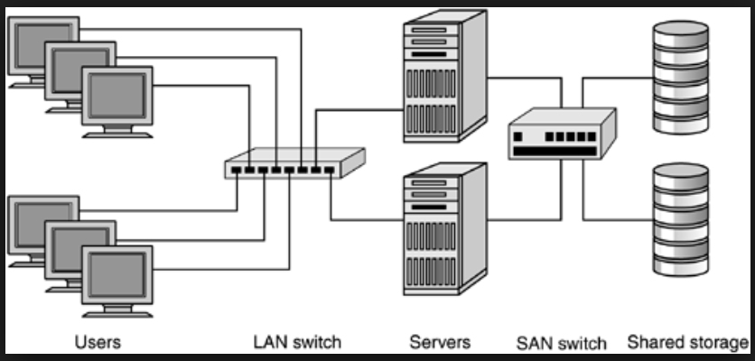
Storage Area Network (SAN)

Slide 25
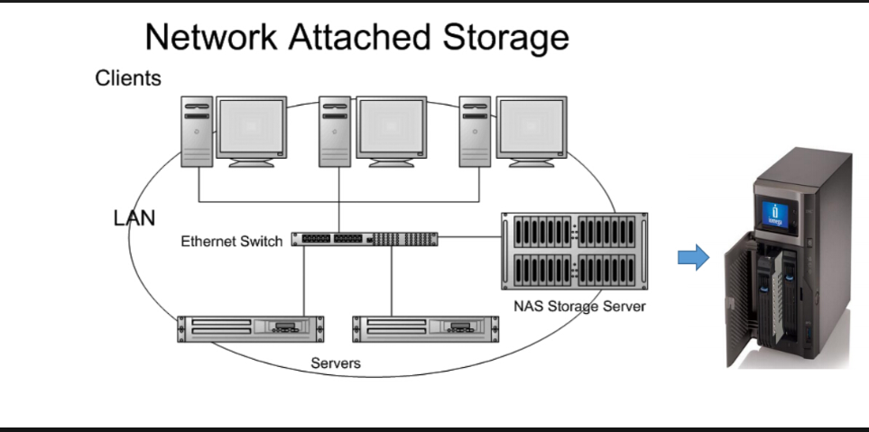
Network Attached Storage (NAS)

Slide 26
Storage Spaces and Storage Pools
Storage Spaces lets you group industry-standard disks into at least one storage pool
You can then create virtual disks from the available storage pool capacity
One of the most useful add-ons when using this technology is that you can thin provision a pool and it can grow as needed
If you run low on capacity, just add more drives to the storage pool.
NOTE: In other words, abstract the storage hardware and use the OS to create highly available, highly scalable software-defined storage.

Slide 27
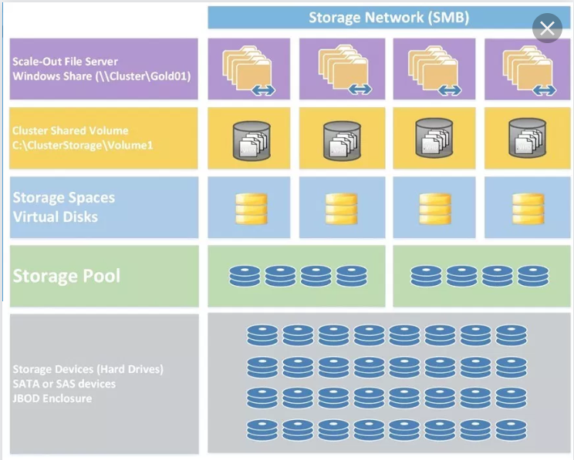
Storage Spaces and Storage Pools - continue

Slide 28
Storage Spaces and Storage Pools - continue
The Storage Space Layout options are:
Simple - limited to one disk (can be non-contiguous portions)
Mirror - RAID-1
Parity - RAID-5 (stripe with parity)
The Storage Space Provision options are:
Thin = volume will use spaces as needed
Fixed = fixed size volume

Slide 29
Storage Spaces and Storage Pools - Lab
Use the existing drives to create a Storage Pool
Use the Storage Pool to create Storage Space
Create the following volumes:
Simple
Mirror
Parity
Experiment with Thin and Fixed provisions
NOTE: May not have enough disks to experiment with all of the above options at the same time.

