Slide 1
Project Stakeholder Management

Slide 2
Outline
Definition of stakeholder
Typical stakeholders
Stakeholder management
Stakeholder Analysis
The stakeholder register

Slide 3
Stakeholder definition
People, groups or organizations that could impact or be impacted by the project
Source: PMBOK Guide, Fifth Edition, Page 391.

Slide 4
Stakeholder management
Identify stakeholders, analyze stakeholder expectations and their impact on the project, and develop appropriate management strategies for effectively involving stakeholders in project decisions and execution.
Source: PMBOK Guide, Fifth Edition, Page 391.

Slide 5
The stakeholder register
Used throughout the project
A table used to manage interactions with the stakeholders
Lists all stakeholders and stakeholder groups
Information added and updated throughout the phases of the project:
Interests, involvement, interdependencies, influence on project success
All interactions with each stakeholder or group, whether planned or not, whether initiated by the project or by the stakeholder
Who on the project team is responsible
Closely related to the project communication plan

Slide 6
Project Initiation: Identify Stakeholders
Top Management
Your Manager
Peers
Resource Managers
Internal Customers
External Customers
Government
Contractors, Subcontractors, Suppliers
Others (the public, landowners, interest groups, business competitors)

Slide 7
Stakeholder Analysis
Who are they?
What are their interests?
Will their interest level vary throughout the project?
Can coalitions be built?
The power/interest grid

Slide 8
Project sponsor
The person or group responsible for enabling success.
May be inside but is usually outside the project.
Signs off that the project is complete—the one the PM has to satisfy.
The person responsible for escalating issues that are beyond the control of the PM.
Significant role in developing the initial charter and project plan.
Source: PMBOK Guide, Fifth Edition, Page 32.

Slide 9
Politics of Projects
The environment
The goals of each stakeholder or group
Goals that are openly stated or clear
Hidden agendas?
Power

Slide 10
Cultural influences
Groups and individuals may differ with regard to:
Communications
Negotiations
Decision-making

Slide 11
Relationship building
Analyze stakeholders
Assess influence
Understand expectations
Define success
Keep stakeholders involved
Keep stakeholders informed

Slide 12
Build respect
Be honest
Take ownership
Be predictable and reliable
Stand by decisions
Take accountability for mistakes
Supportive stakeholders are essential to project success!

Slide 13
Stakeholder management tools
Power/interest matrix
Cooperation-Threat matrix
Stakeholder analysis template
Stakeholder Register
Communication Plan

Slide 14
The power/interest grid
High
Keep Satisfied | Manage Closely
Monitor | Keep Informed
Power
Low
Low
Interest
High
Source: PMBOK Guide, Fifth Edition, Page 32.

Slide 15
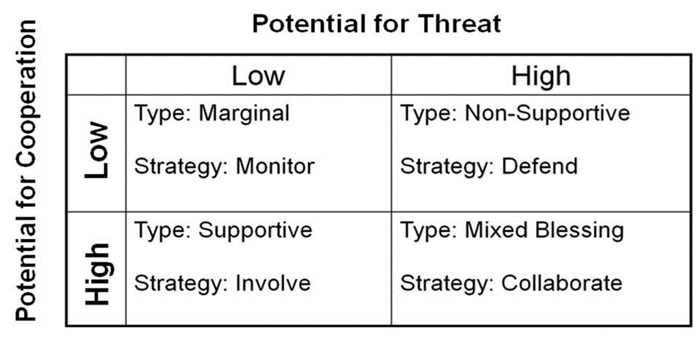
Cooperation-Threat Matrix

Slide 16
Engagement levels
May classify in more detail than in Initiation phase:
Unaware
Resistant
Neutral
Supportive
Leading
For each stakeholder or group. Consider potential movement from one level to another throughout the project.

Slide 17
Stakeholder management plan
A component of the Project Management Plan
Desired and current engagement levels with stakeholders
Scope and impact of project on stakeholders
Interrelationships between stakeholders
Stakeholder communication requirements and plan
Time frame, frequency, format and content of planned communications to stakeholders
Method for updating the stakeholder management plan

Slide 18
Manage Stakeholder Engagement
Communicating and working with stakeholders to meet their needs and expectations
To increase support and reduce resistance from stakeholders
Increase the probability of project success

Slide 19
Summary
Stakeholders are people, groups or organizations that could impact or be impacted by the project
Managing stakeholders is a key success factor for projects
Analyze stakeholder interests and level of influence
Build coalitions
Communicate with Stakeholders

Slide 20
Questions?

