Slide 1
Project Implementation

Slide 2
Project Implementation Phase

Slide 3
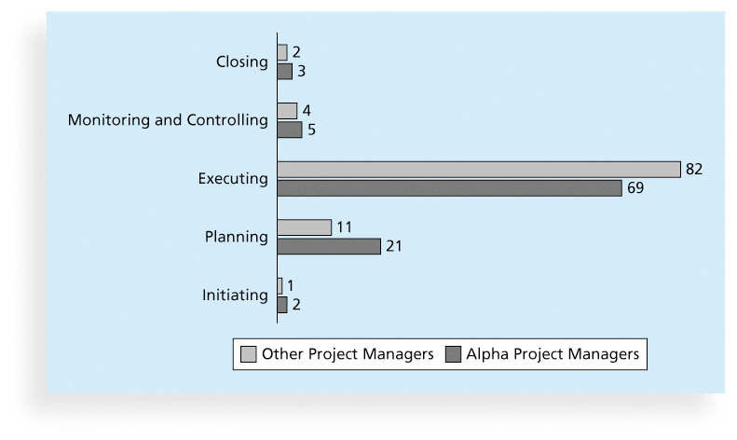
Percentage of Time Spent on Each Process Group

Slide 4
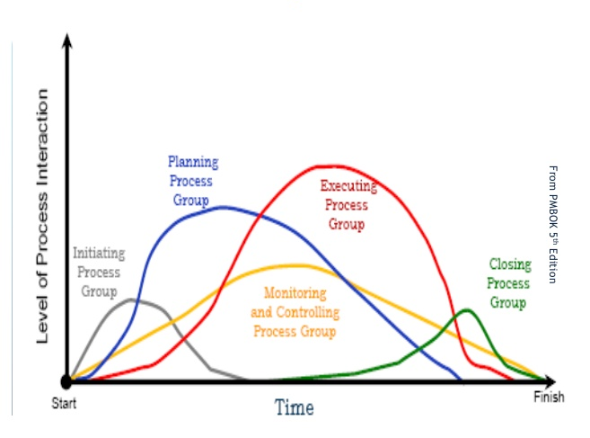
Relationship between Project Management Process groups

Slide 5
Execution Phase Components
NOTE: Remember the, “you can’t control/manage what you don’t measure” quote
Critical components of the Execution phase:
Execute the project plan – duh!
Capture progress against Scope, Timeline, Budget, and Quality
NOTE: This is a lot of work!
Compare progress against baselines
Communicate progress, milestones, issues, and plans to address issues:
Be authentic
Sooner is better

Slide 6
Execution Phase Components - continues
Address change requests (Change Request Process):
Never worked on a project without changes
Can’t just ignore or dismiss change requests (not a smart career move)
When a change is approved, update the plan (including baselines)
Celebrate important milestones

Slide 7
Questions?

