Slide 1
Communication Planning

Slide 2
Project Communication
Definition and Importance
Cultural issues
Communication Requirements Analysis
Types of communication
Communication Plan

Slide 3
Communication
Throughout the project a need to communicate to
Project Sponsor
Team members
Other stakeholders
Customers
Clients
Suppliers
Partners
The public

Slide 4
For each group
Purpose
Frequency
Format
Amount of time
Possible need for a hierarchy of reporting:
Portfolio
Program
Project
Task group

Slide 5
Synchronous Options
Face to face
Synchronous but not in same place– (remember the time zones!)
Conference call
Video link
Computer-assisted video conference
IM; texting

Slide 6
Asynchronous Options
Courier, mail
E-mail
Fax
Project Blog
RSS
Social media presence

Slide 7
Communication Planning
Who?
Why?
What do they need/want to know? Or communicate to the project?
When? How frequently?
How? (what method(s) do they prefer? Are there methods that are unsuitable?
Who will be the contact point from the project for this communication?

Slide 8
Team Meetings
Purpose is to verify progress, identify challenges and get assistance where needed.
Frequency and duration may vary throughout the project
Be considerate and schedule “off-line” meetings if only a few are involved in a particular item. It wastes the time of the rest.
Frequent very short meetings may be more effective with a small team (daily “stand-up” meetings are a standard part of Agile Systems Development.)
PM may need to meet and report with other PMs in the same program or portfolio.

Slide 9
Report to Management or Sponsor
Frequency and format may be dictated by Sponsor
Purpose to report progress, identify challenges and changes, get support for necessary changes or added resources
Need balance between “raising the alarm” too early and waiting too long and being “in too deep”

Slide 10
Other stakeholders
Community may need to be consulted, informed—Riverview Lands project in Coquitlam.
Business customers or suppliers may be impacted by the project.
Project contractor/supplier needs to know about other aspects of the project, and to inform PM of status.
Government may have a role—permits, inspections, other
The Project Management Office
Frequency, format and content of communications may be dictated by law or may be a provision of a contractual agreement.

Slide 11
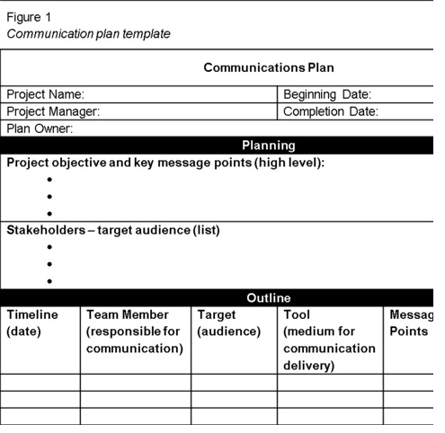
Communication Plan template
Figure 19.2.1 Communications Plan example
Source: http://inte5160.wikispaces.com/Communication+Plans

Slide 12
Summary: Project Communication
Project communication is a key success factor
Start with a Communication Requirements Analysis and then Prepare a Communication Plan that considers all the stakeholders
Consider a variety of synchronous and asynchronous methods
Use appropriate technology
Consider cultural issues when planning and carrying out project communication
Remember communication is a two-way process, not always “broadcast!”

Slide 13
Questions?

