Slide 1
Project Management: Past and Present

Slide 2
Project Management Past and Present
This chapter introduces project management as an important activity in many different careers and industries.
The chapter presents a brief overview of the history of project management tools and project management professionalism.

Slide 3
Careers Using Project Management Skills
Everyone carries out projects, every role in every organization.
Projects can be any size from one-person doing his or her homework to thousands of people working together with billion-dollar budgets.

Slide 4
Project management skills
Planning
Communication
Delivering results
Monitoring risks
Managing resources

Slide 5
Industry sectors
Business owners
Agriculture and Natural Resources
Arts, Media and Entertainment
Building Trades and Construction
Energy and Utilities
Engineering and Design
Fashion
Finance
. . . continued on next slide

Slide 6
Industry sectors (continued)
Health and Human Services
Hospitality, Tourism and recreation
Manufacturing and Product Development
Education
Public Services
Retail and Wholesale Trade
Transportation
Information Technology

Slide 7
History of Project Management
Early methodologies not well-documented, but results still stand: the pyramids, Stonehenge, mass human migrations
Late 19th century:
Construction of intercontinental railroad, other large projects
Early 20th Century:
Frederick Taylor created Scientific Management of industrial processes
Henry Gantt developed a bar-chart approach to illustrating timing of project tasks and progress

Slide 8
History of Project Management (continued)
Mid-20th century
CPM and PERT methodologies identified the importance of task sequences, task dependencies and the concept of the critical path.
Project management as a profession
Project Management Institute (PMI) was founded
Project Management Body of Knowledge (PMBOK) was created

Slide 9
History of Project Management (continued)
Today
Increasing recognition of project management as a specialized set of skills applicable to many different industries
Project Management certifications: PMP, CAPM, specializations
PMBOK is in its 5th edition
Variations on methodologies:
phased (waterfall approach)
Agile methods
The importance of integrating projects into portfolios and programs (more on this in chapter 2)

Slide 10
Project Management Institute (PMI) (http://www.pmi.org)
The Project Management Institute (PMI) is an international professional society for project managers founded in 1969
PMI provides certification as a Project Management Professional (PMP)
A PMP has documented sufficient project experience, agreed to follow a code of ethics, and passed the PMP exam
The number of people earning PMP certification is increasing quickly (see next slide)
PMI offers other Project Management certifications (see next slide)

Slide 11
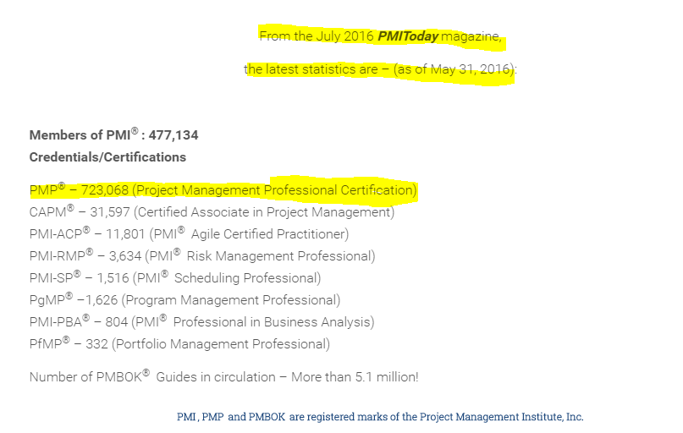
PMI Certifications

Slide 12
Why Project Management?
Project Management is a mixture of science and art:
Science = Methodologies and tools
Art = Estimating time, cost, quality, and soft skills
One does not have to look hard to identify many failed projects led by professional entities
So, why use structured project management?
Because studies have shown the well managed projects have a much better odds at completing projects on time, budget, and desired quality

Slide 13
Summary
Project management has existed as long as humans have worked together to achieve goals
Project management skills are useful in all careers
Project management takes place in all industries
Project management tools and methodologies have evolved over the past century and a half:
Scientific management
Gantt chart
Pert/CPM network diagrams
There are associations of professional project managers that set standards for the practice of project management
PMI’s Project Management Body of Knowledge or PMBOK, currently in its fifth edition.

Slide 14
Questions?

