Slide 1
Culture and Project Management

Slide 2
Culture and Project Management
Definition of Organizational Culture
Project Manager’s Checklist
Team Challenges
Dealing with conflict

Slide 3
Organizational Culture
Shared beliefs, attitudes, values
Behaviors that arise from the beliefs, attitudes and values
May be obvious or subtle
Culture definition:
The way we do things here
Familiar and acceptable

Slide 4
Project Manager’s Checklist
Decision-making—who makes the decision and what processes are followed
Communication
Formality
Medium
Complexity
Vocabulary and format— “Image”

Slide 5
Team Challenges
Individual identity
Verbal and emotional expressiveness
Relationship expectations
Style of communication
Language
Personal priorities, values and beliefs
Time orientation

Slide 6
Dealing with Conflict
Conflict is not a bad thing
Problem-solving is a key activity for successful teams
Understanding your own preferred approach and those of your team helps in productive conflict resolution

Slide 7
Five basic approaches to conflict resolution
Avoidance/Withdrawal
Accommodation/Smoothing
Compromise
Collaboration/Problem-Solving
Forcing/Competition

Slide 8
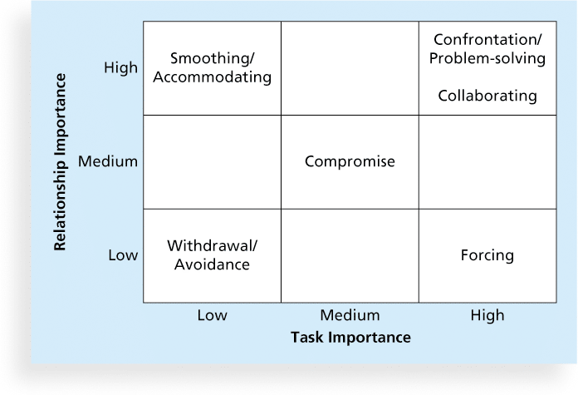
Conflict Handling Modes

Slide 9
Culture and Project Management
Organizational Culture means shared beliefs, attitudes and values, along with related behaviors
Project Managers need to be aware of cultural issues
Team Members can also face challenges in cross-cultural relationships
Effectively dealing with conflict is a success factor for projects—every project team must resolve differences and make decisions

Slide 10
Questions?

