Slide 1
Scope Planning

Slide 2
Scope Planning
Defining the scope
Project requirements
Scope Inputs
Requirements traceability matrix
Work Breakdown Structure (WBS)
Scope statement

Slide 3
Project Scope
One of the main activities in the Project Planning phase is determining and documenting the project scope.
Project scope is the definition of all the work needed to successfully meet the project objectives.

Slide 4
Deliverables
Must be described in a sufficiently low level of details

Slide 5
Scope
Be as specific as you can
Where possible, the scope statements should include how the results will be measured so you and your sponsor will know with certainty whether that part of the scope has been achieved
Requirements should tie to things like the organization’s strategic plan and business objectives
Mention things that are explicitly NOT included: is this limited to certain locations? If in an international context, is it in only one language?

Slide 6
Scope
Not measurable | Measurable
A new registration system | With the new system, students will be able to register for classes using a browser or a smartphone.
The system will be fast | Response time will be under 1 second
The system will support the required volumes | 75 students must be able to add an average of 3 classes each 15-minute period.
Happy users | User satisfaction will be measured by a standardized set of questions and will measure 5 or higher on a 7-point scale.

Slide 7
Types of requirements
Functional
Non-functional
Performance
Development
Technical
Business
User
Regulatory

Slide 8
Software requirements fundamentals
Unique challenges
Must be verifiable

Slide 9
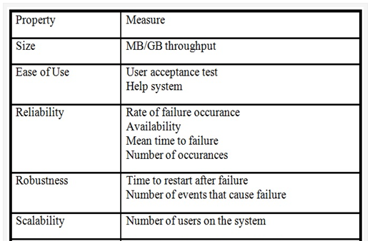
Measuring requirements
Each type of requirement may require a different type of measure:

Slide 10
Scope inputs-techniques
Interviews
Focus groups
Facilitated groups– JAD, QFD
Group creativity techniques such as brainstorming
Prototyping
Observation
Questionnaires and surveys

Slide 11
Scope Inputs-sources
Project sponsor
Management
Strategic Plan
Users
Customers
Competitors
Suppliers
Regulations
and others

Slide 12
Requirements Traceability Matrix
Links requirements to their origin
Traces them throughout the project process
May link requirements to:
business needs, opportunities, goals, and objectives;
project objectives;
project scope/WBS deliverables;
product design;
product development;
test strategy and test scenarios;
or may link
High-level requirements to more detailed requirements.

Slide 13
Simplified Requirement Traceability Matrix
Code | Description | Source | Priority | Status
5 | User interface must comply to company standard | Corporate IT standards manual | 1 | In-progress
5-1 | Help text uses corporate fonts | Corporate style manual | 2 | complete
8-6 | Include the users in the testing | Project Charter, item 7 | 1

Slide 14
Requirements Traceability Matrix fields
Unique identifier
Requirement statement
Source
Design specification reference
Test specification
Test case numbers
Remarks
… and more depending on the particular situation

Slide 15
WBS Creation
List all the project outputs (deliverables and other direct results);
Identify of all the activities required to deliver the outputs.
Subdivide the activities into sub-activities and tasks.
Identify the deliverable and milestone(s) of each task

Slide 16
Creating the WBS
A list of all activities required to create all the deliverables in the scope.
Activities may be broken down into smaller tasks, in a hierarchical pattern
Do not focus on sequence or dependencies at this point

Slide 17
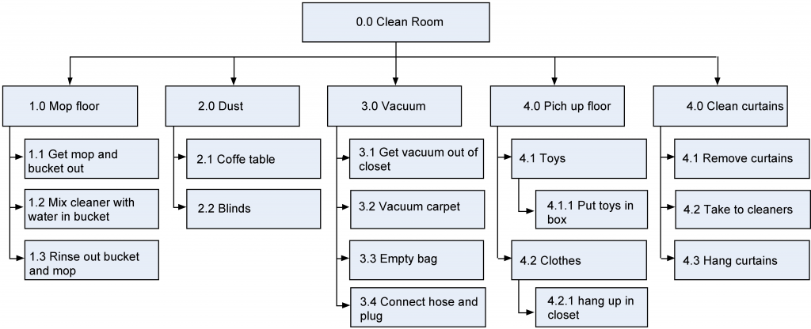
Creating the WBS

Slide 18
Creating the WBS
Follow a numbering plan
Can also be shown in outline format
May be very complex for a large project

Slide 19
WBS Creation
Remember the 100% Rule:
The combination of the boxes on each level represent 100% of the parent box.

Slide 20
WBS Creation
At the lowest level, the WBS consists of Work Packages
It is important that each work package is clearly defined and can be easily assigned
The work package level is where time estimates, cost estimates and resource estimates are determined.

Slide 21
Scope Statement
Purpose:
Project deliverables
Major objectives
Measurable success criteria
Create and use a template suitable to your organization

Slide 22
Scope Statement Typical Contents
Project Name
Project charter
Owner, sponsor, project manager, stakeholders
Problem statement
Project Goals and Objectives
Project Requirements
Project Deliverables
Exclusions
Milestones
Cost estimates

Slide 23
Summary
Scope planning is an essential activity during the planning phase of the project
Provide relevant details and measurable deliverables in your scope
Use a Requirement Traceability Matrix to relate the deliverables to their sources and keep track of status
Create a WBS as a hierarchy
Remember the 100% rule
. . . continued on next slide

Slide 24
Summary (continued)
The scope statement includes
Project Name
Project charter
Owner, sponsor, project manager, stakeholders
Problem statement
Project Goals and Objectives
Project Requirements
Project Deliverables
Exclusions
Milestones
Cost estimates

Slide 25
Questions?

