Slide 1
Project Management Overview

Slide 2
Purpose of the chapter
Define a project
Define project success
Projects vs. Operation
Project constraints
Project management expertise
The project environment
Project management knowledge and skills
Define a program
Define a portfolio
Define Project Management Office (PMO)

Slide 3
Define a project
A project is “a temporary endeavor undertaken to create a unique product, service, or result” (PMBOK® Guide, Fifth Edition, 2012)
Projects are time-limited/temporary (start and end)
Project ends when the objectives are achieved or abandoned
Projects Involves risks/uncertainties
Projects can be small, medium, or large
Projects developed using progressive elaboration

Slide 4
Unique
How can you tell that an activity is unique?
Completely new product or service
Creation of new process
Product or service new to this group of people

Slide 5
Time-limited/temporary
Has a start and an end date
May be measured as “will be complete when a particular objective is achieved”
If it simply continues forever or to an unspecified end-date it is probably an ongoing business activity = Operations

Slide 6
Can tell when it is done
Objective is achieved
Time limit is reached
Objective is abandoned/cancelled

Slide 7
Project success
Traditionally: on time, within budget and delivers the promised scope
More effective measure: satisfied customer

Slide 8
Projects vs. Operations
Projects | Operations
Temporary (start and end) | Ongoing
Unique | Repetitive/Continuous
Project Management | Process Management
Special funding | General funding
Accomplish objectives and terminate | Sustain the business (make money)
1) Both require resources (people, equipment, etc.) 2) Both are subject to constraints (people, time, $$, etc.) 3) Both are planned and executed 4) Both are designed to meet business objectives.

Slide 9
Examples of Projects and Operations
Projects | Operations
Developing Boeing 787 | Producing, maintaining, and supporting Boeing 787s
Developing Facebook.com | Maintaining and supporting Facebook.com
Building a home | Maintaining a home
Boeing has been producing 747s since 1970, operation, over the years has upgraded different components of the 747 (each upgrade is a project) Each Facebook.com upgrade is a project Building a fence or remodeling a kitchen are projects.

Slide 10
Group work
In small groups, try to identify the LARGEST project each of you have been involved with.
You do not have to have been the project manager—if not, what was your role? (team member, volunteer, purchaser, ??)
With the group, make it clear how the project you have identified meets the criteria:
Unique
Temporary

Slide 11
Project constraints
Scope
Time
Cost
Quality
Resources
Risk

Slide 12
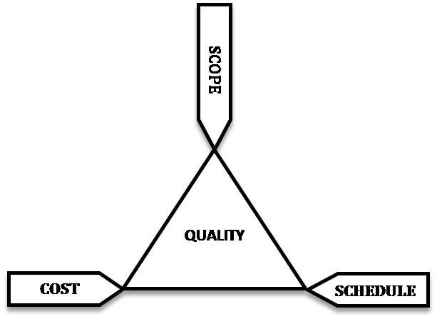
Triple constraint
All the constraints can be grouped into these three:
The triad constraints by John M. Kennedy T. (http://commons.wikimedia.org/wiki/File:The_triad_constraints.jpg) used under CC-BY-SA license (https://creativecommons.org/licenses/by-sa/3.0/)

Slide 13
Project Management Expertise
Application knowledge
Industry group
Technical specialty
Managerial area
Understanding the project environment
Cultural, social, political, international, physical
Management knowledge and skills
Interpersonal skills
Communication, influence, leadership, motivation, negotiation and problem solving

Slide 14
Project Management Standards
Standards organizations
PMI
Project Management Institute: http://www.pmi.org/
CAPM, PMP and other professional standards
IPMA
International Project Management Association: http://ipma.ch/
Several certifications

Slide 15
Program Management
When the objectives are large and complex (i.e. Boeing 787 or MS Office 365), they are often managed as a Program
Program: group of related projects managed in a coordinated way to obtain benefits and control not available from managing them individually (PMBOK® Guide, Fifth Edition, 2012)
Fro example, the Boeing 787 program could consist of the following interdependent/related projects:
Body
Wings
Interior
Computers and Software
Each of the above projects will be managed by a separate Project Manager and the entire program managed by a Program Manager

Slide 16
Portfolio Management
Portfolio Management = Group and manage projects and programs as a portfolio of investments that contributes to the business success
Strategic Portfolio Management:
Help the business make wise investment decisions (select the projects that best align with and deliver on the business’ strategic objectives)
Tactical Portfolio Management:
Help manage ongoing projects and programs
Are the ongoing projects and programs on track? Will they deliver on commmitments?
Are the stakeholders up-to-date?

Slide 17
Project Management Office (PMO)
A project management office (PMO) is a group or department within a business, agency or enterprise that defines and maintains standards for project management within the organization. The PMO strives to standardize and introduce economies of repetition in the execution of projects.

Slide 18
PMI Certifications
CAPM = Certified Associate in Project Management
PMP = Project Management Professional
PgMP = Program Management Professional
PMI-ACP = PMI Agile Certified Professional
PMI-RMP = PMI Risk Management Professional
PMI-SP = PMI Scheduling Professional
PfMP = Portfolio Management Professional

Slide 19
Summary
Project definition: unique, time-limited, can tell when it is over
Project success: satisfied client
Project constraints: time, scope, cost
Project management expertise
The project environment
Project management knowledge and skills
Program management
Portfolio Management
Project Management Office (PMO)

Slide 20
Questions?

